Slide 1
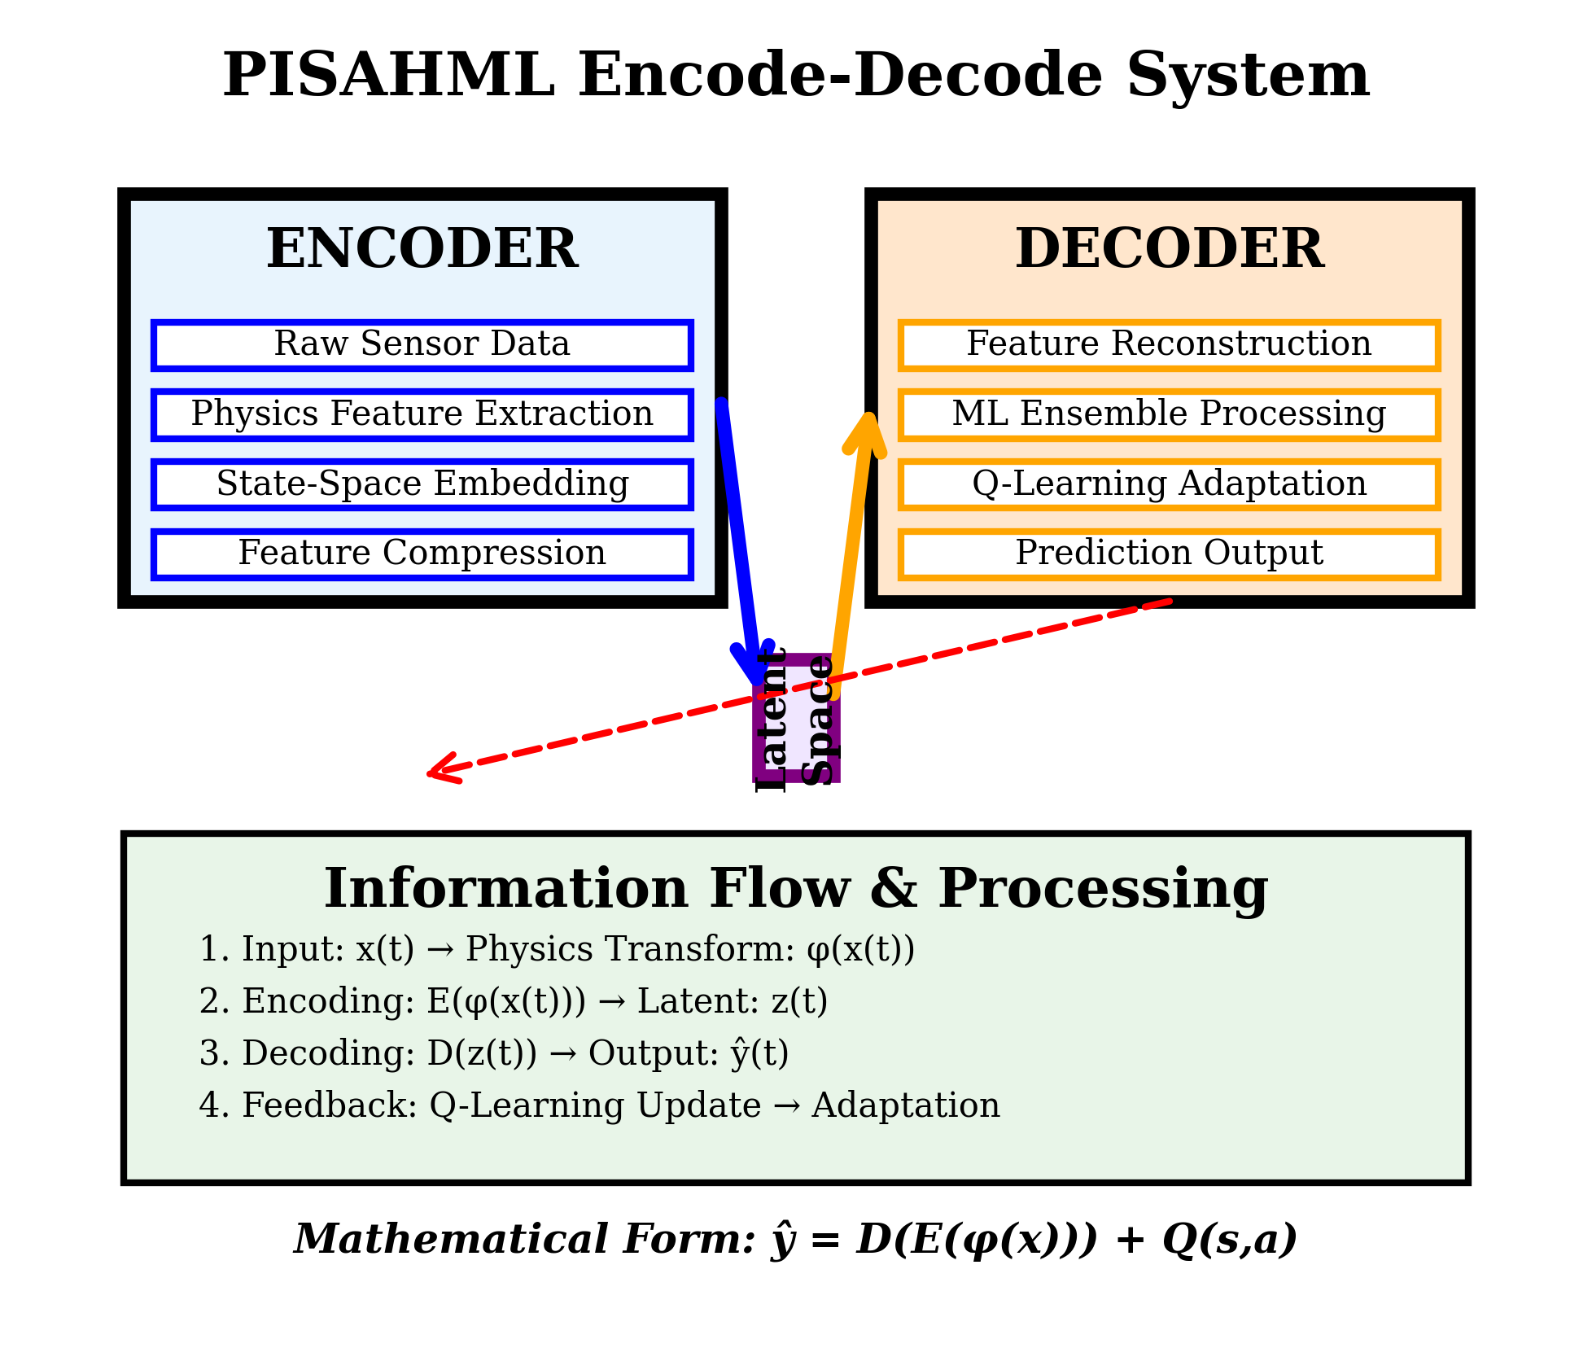
Latent Space
Figure: Physics Informed Self Adaptive Hybrid Machine Learning(PISAHML) Encode-Decode System

Slide 2
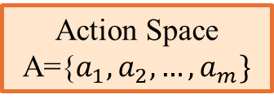
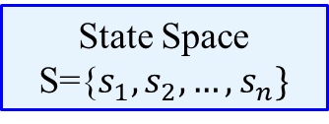
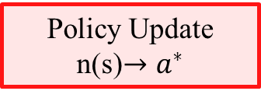
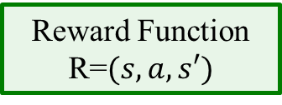
State Space
S={$s_{1},s_{2},…,s_{n}\}$
Action Space
A={$a_{1},a_{2},…,a_{m}\}$
Q-Learning
Core
Policy Update
n(s)$→a^{∗}$
Reward Function
R=$(s,a,s′)$
$$Q\left(s,a\right)←Q\left(s,a\right)+α[r+γ\max{Q\left(s^{′},a^{′}\right)−Q(s,a)]}$$
$$α:Learning Rate, γ:Discount Factor,ε:Exploration Rate$$
Figure: Self Adaptive Q-Learning Mechanism

Slide 3
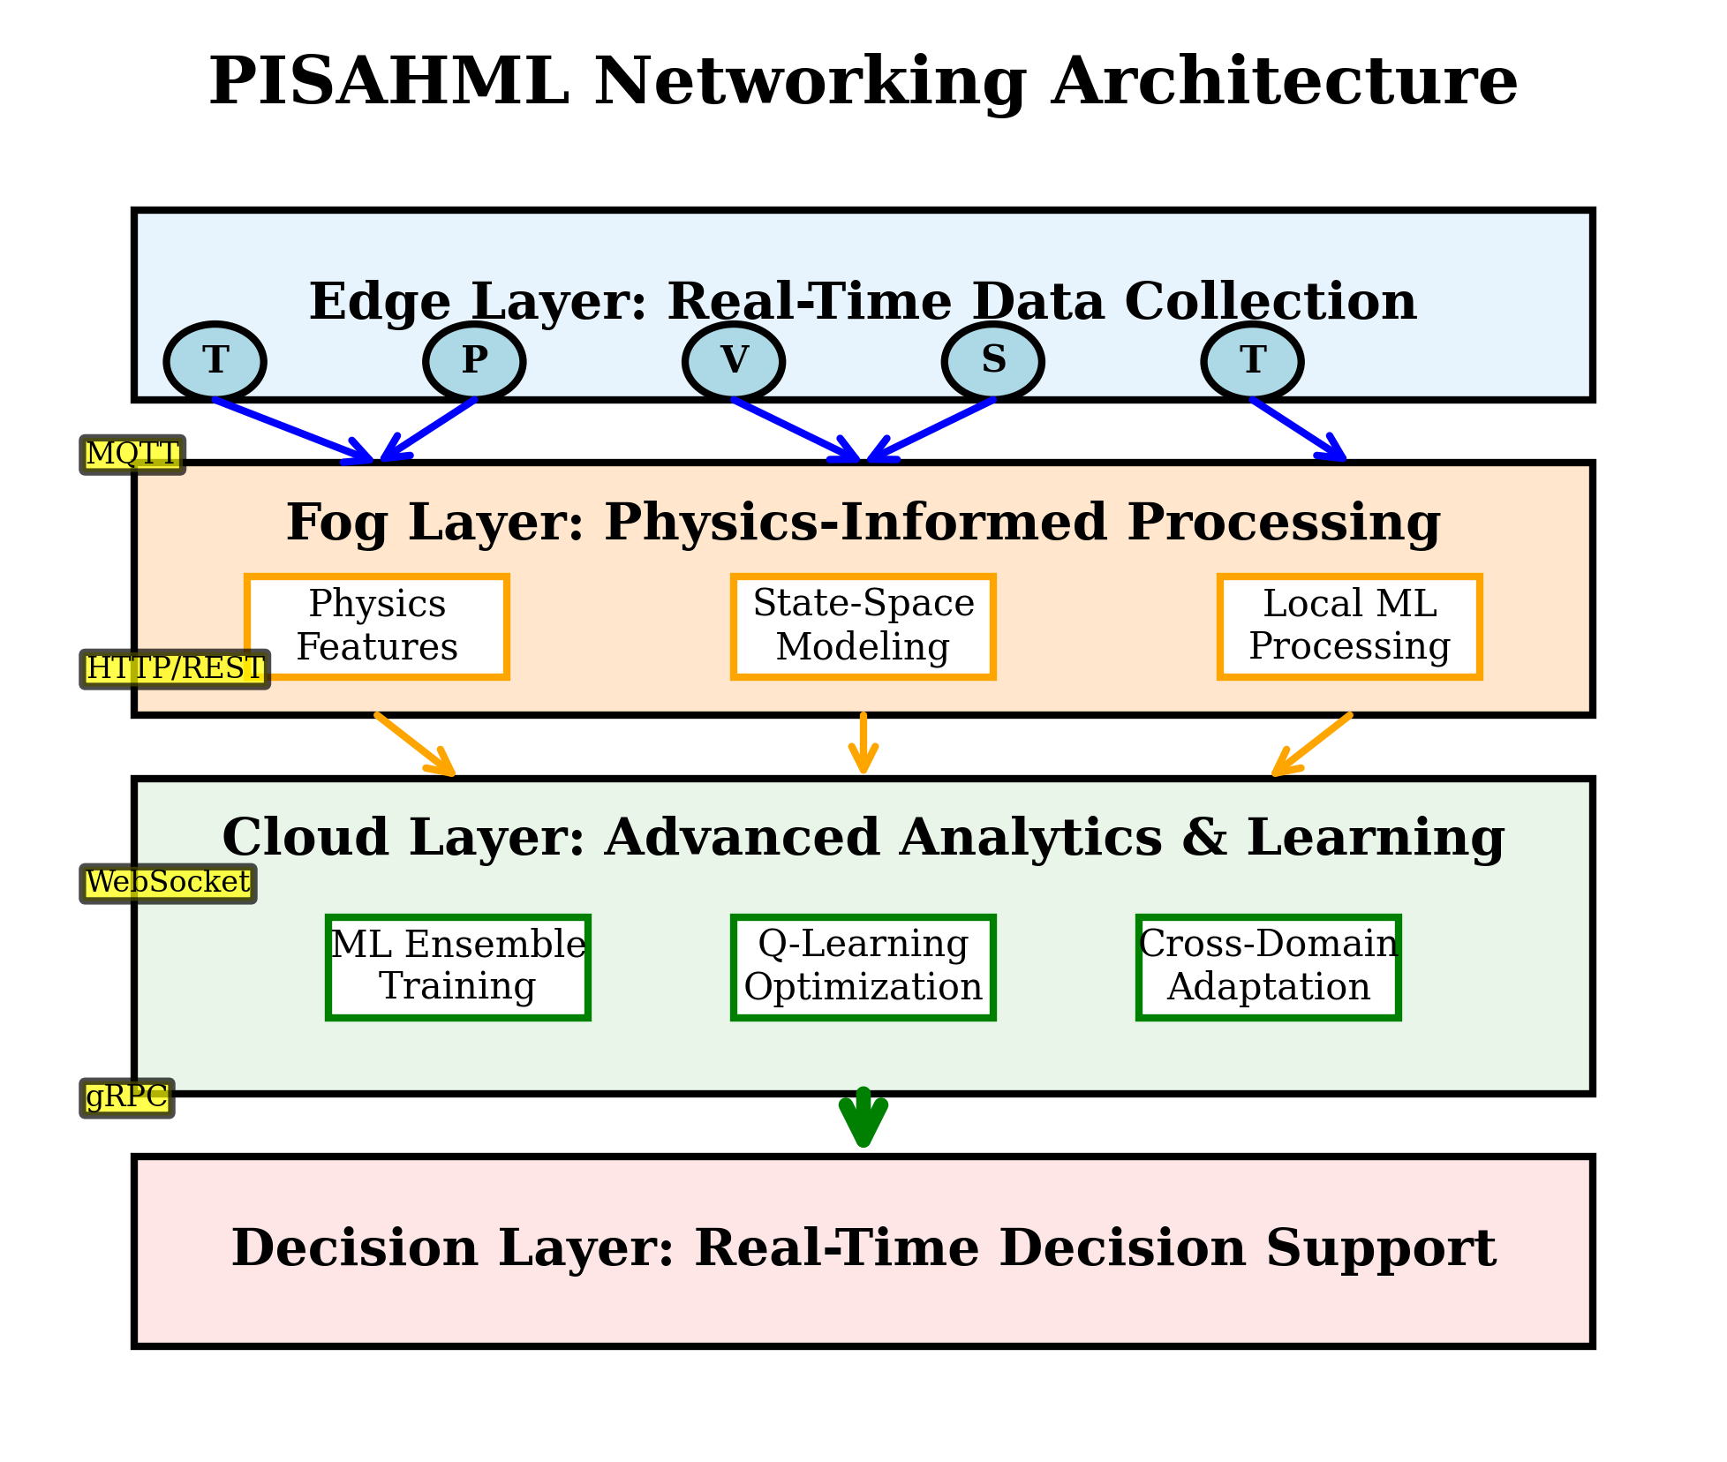

Slide 4
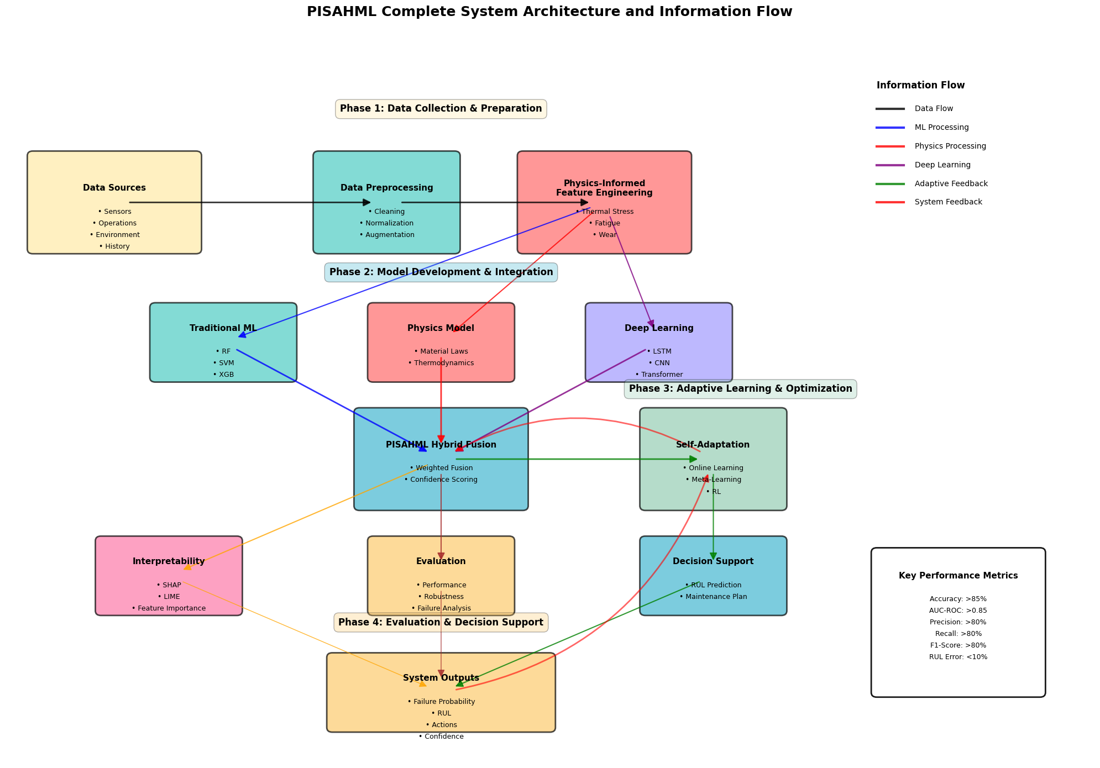
Phase 1: Data Collection & Preparation
Physics Informed Feature Engineering
Thermal Stress
Fatigue
Wear
Arhenius Law
Heat Transfer
Data Source
Sensor
Operations
Environment
History
Data Preprocessing
Cleaning
Normalization
Augmentation
Phase 2: Model Development & Integration
Traditional Model
Random Forest
Gradient Boosting
Neural Network
SVM
MLP
XGB
Physics Model
Thermodynamics
Material Laws
Deep Learning
LSTM
CNN
Transformer
Phase 3: Adaptive Learning & Optimization
PISAHML Hybrid Fusion
Weighted Fusion
Confidence Scoring
State Space Modeling
Dynamic States
Transition
Kalman Filter
Phase 4: Evaluation & Decision Support
Self Adaptation Q-Learning
Action Selection
Reward
Policy Update
Real Time Decision Support System
RUL Prediction
Maintenance Plan
Performance
Failure Prediction
Robustness
Cross-Domain Applicability
Manufacturing
Energy
Transportation
Aersospace

Slide 5
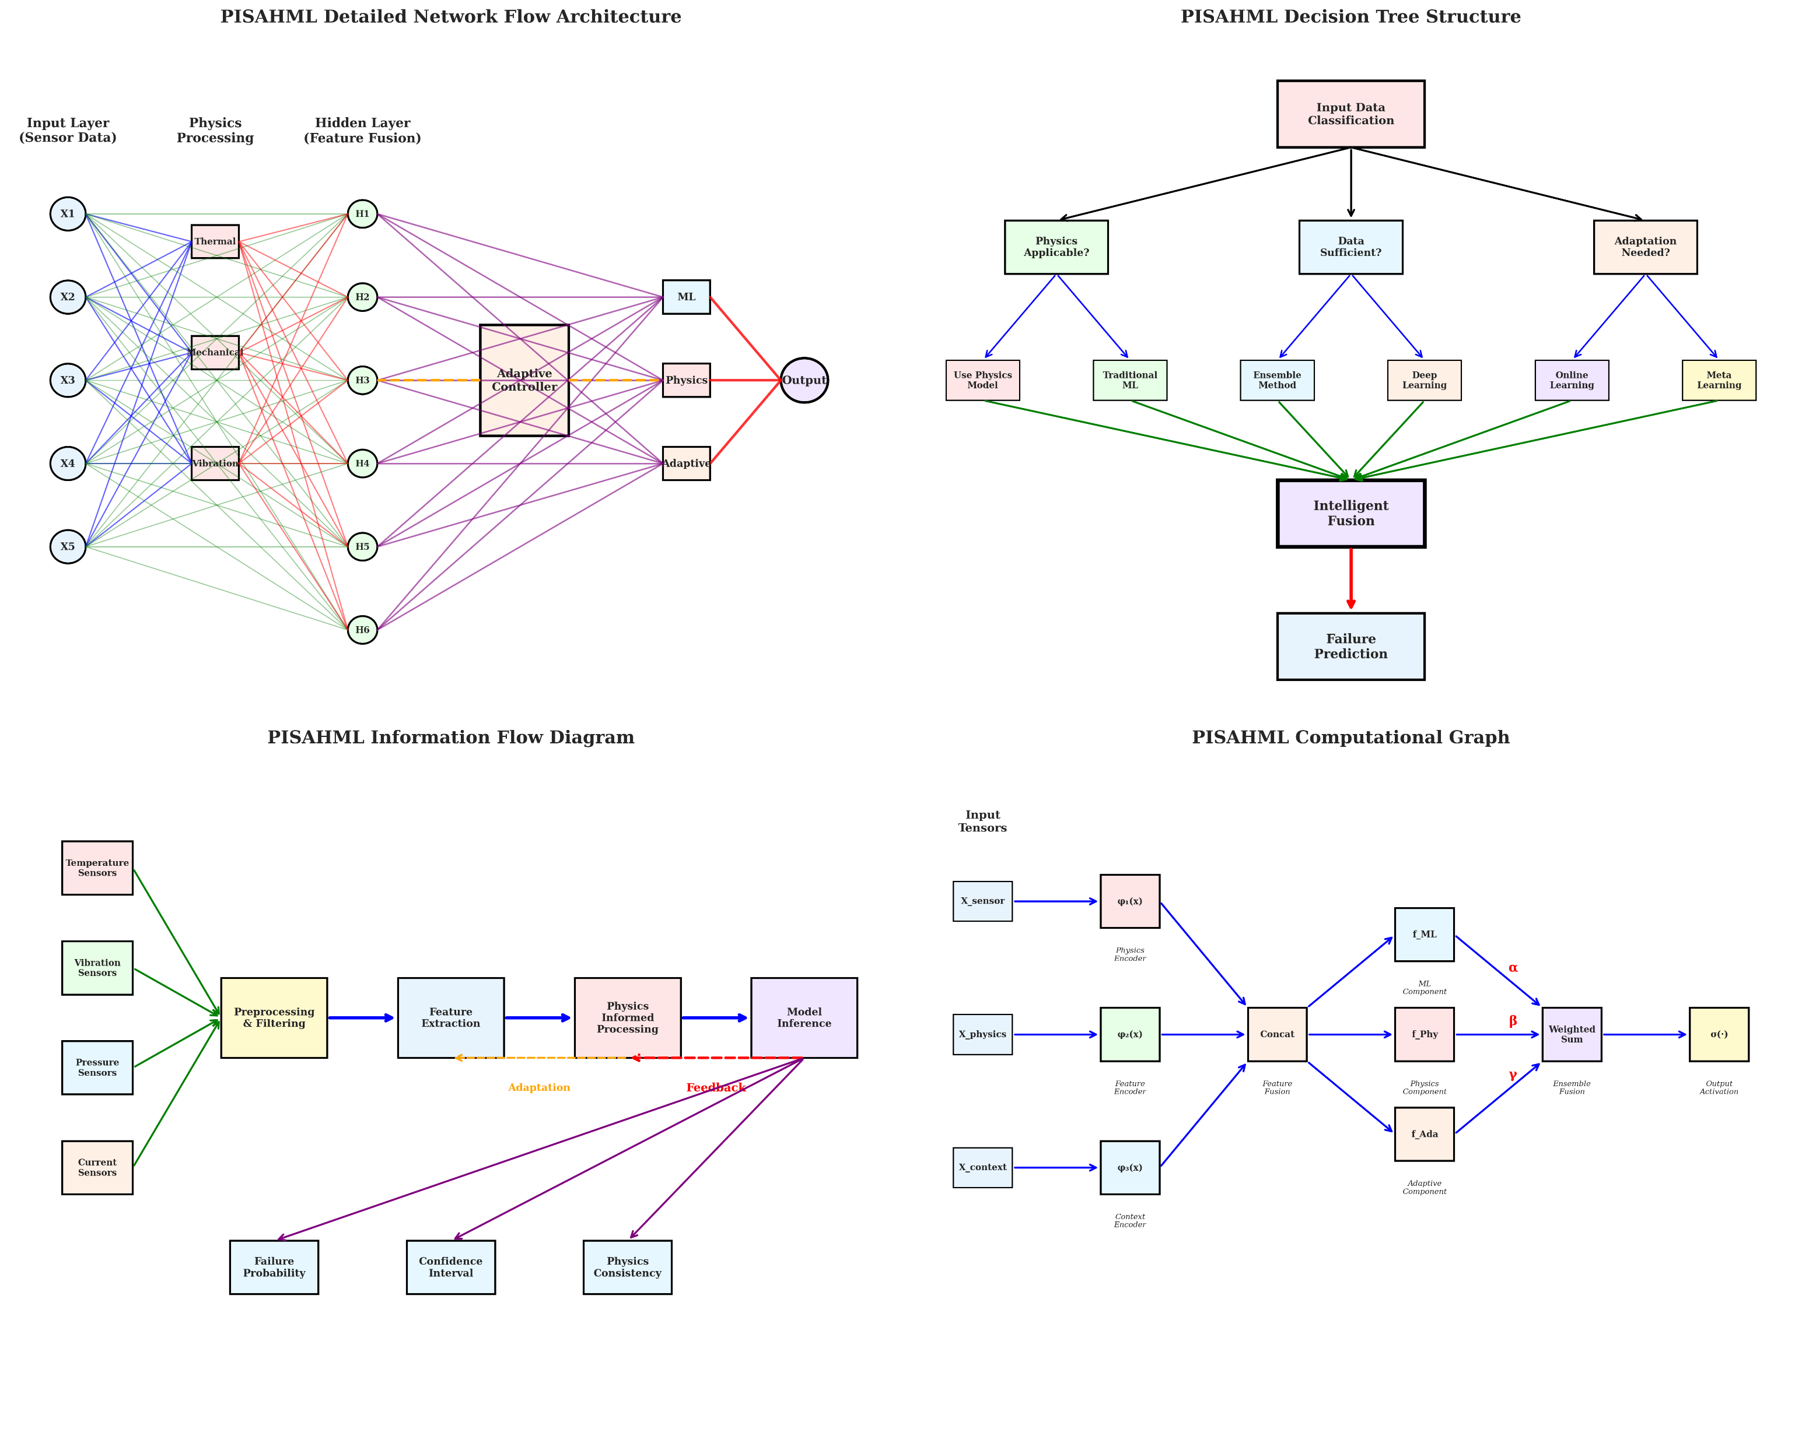
Figure: PISAHML Detailed Network Flow Architecture
Figure:PISAHML Decision Tree Structure

Slide 6
Figure: PISAHML Information Flow Diagram
Figure: PISAHML Computational Graph

Slide 7
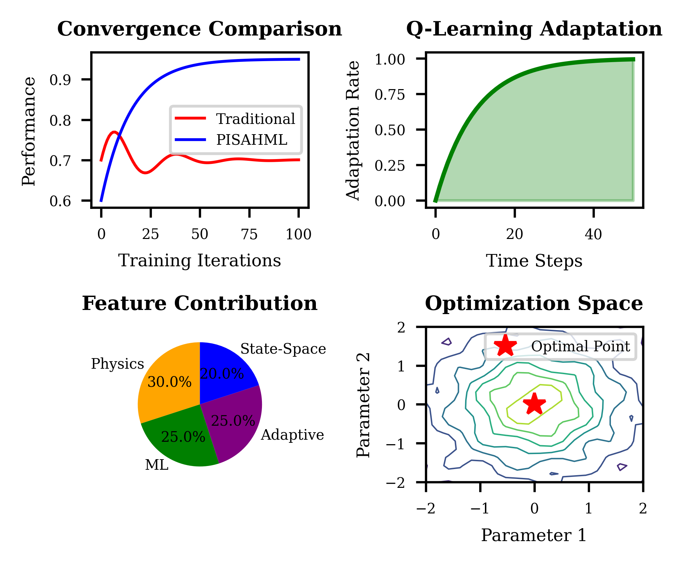
(a)
(b)
(c)
(d)
Figure: (a) Convergance Comparison, (b) Q-Learning Adaptation, (c) Feature Contribution, (d) Optimization Space

Slide 9
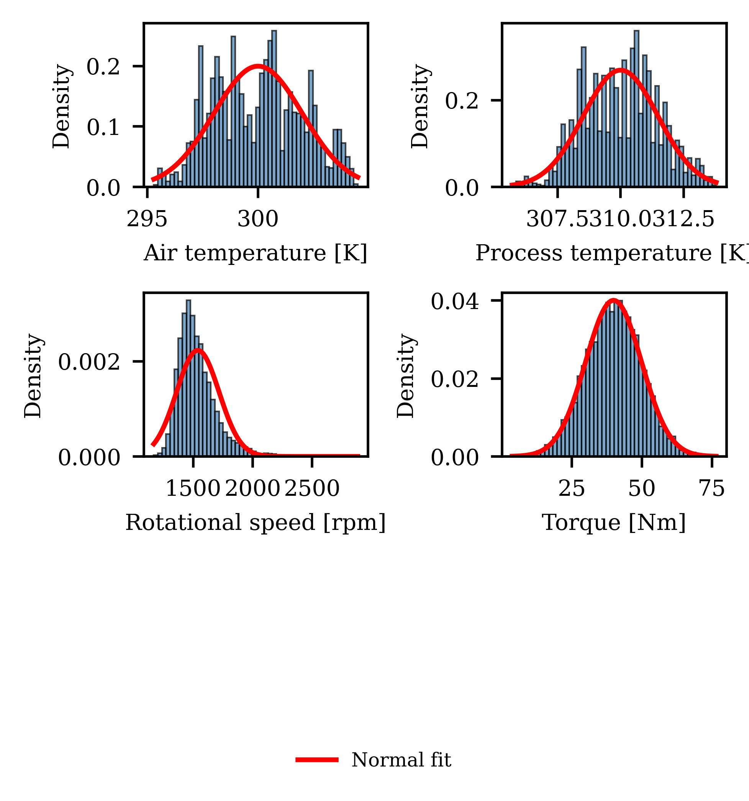


0.3
0.4
Density[-]
Density[-]
0.2
0.2
0.1
0.0
295
300
305
0.0
307.5
310
312.5
Air Temperature[K]
Process Temperature[K]
$$×{10}^{−3}$$
3.75
0.04
Density[-]
2
Density[-]
0.02
0.0
20
$$×{10}^{2}$$
0.0
25
50
75
15
25
Torque[Nm]
Rotational Speed[rpm]
Normal fit

Slide 10
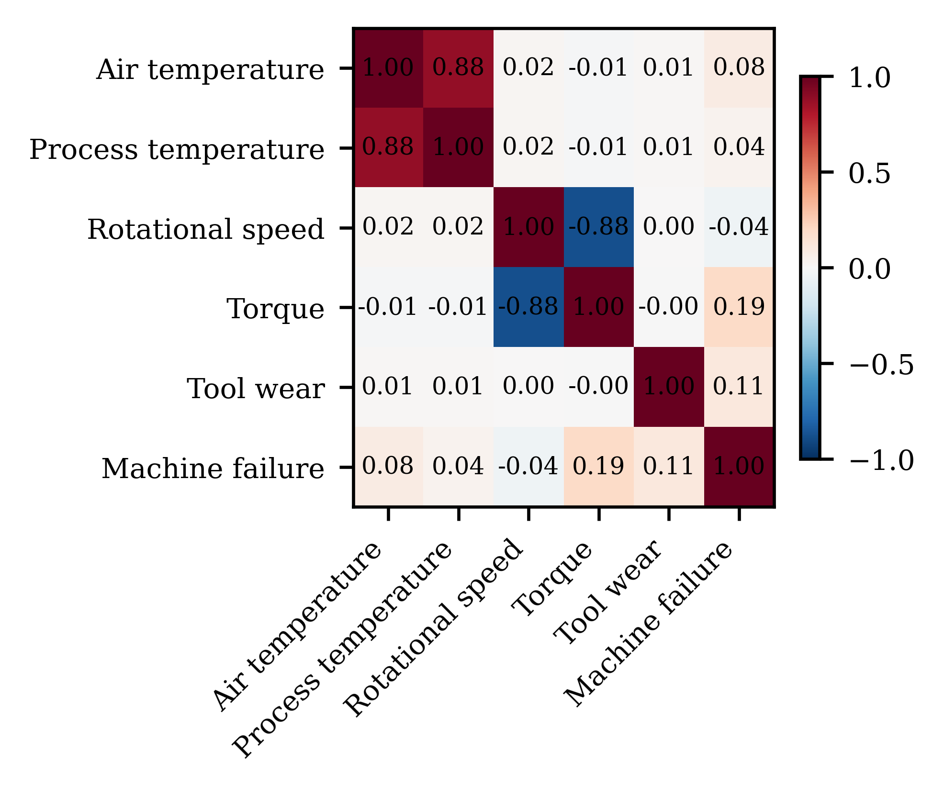
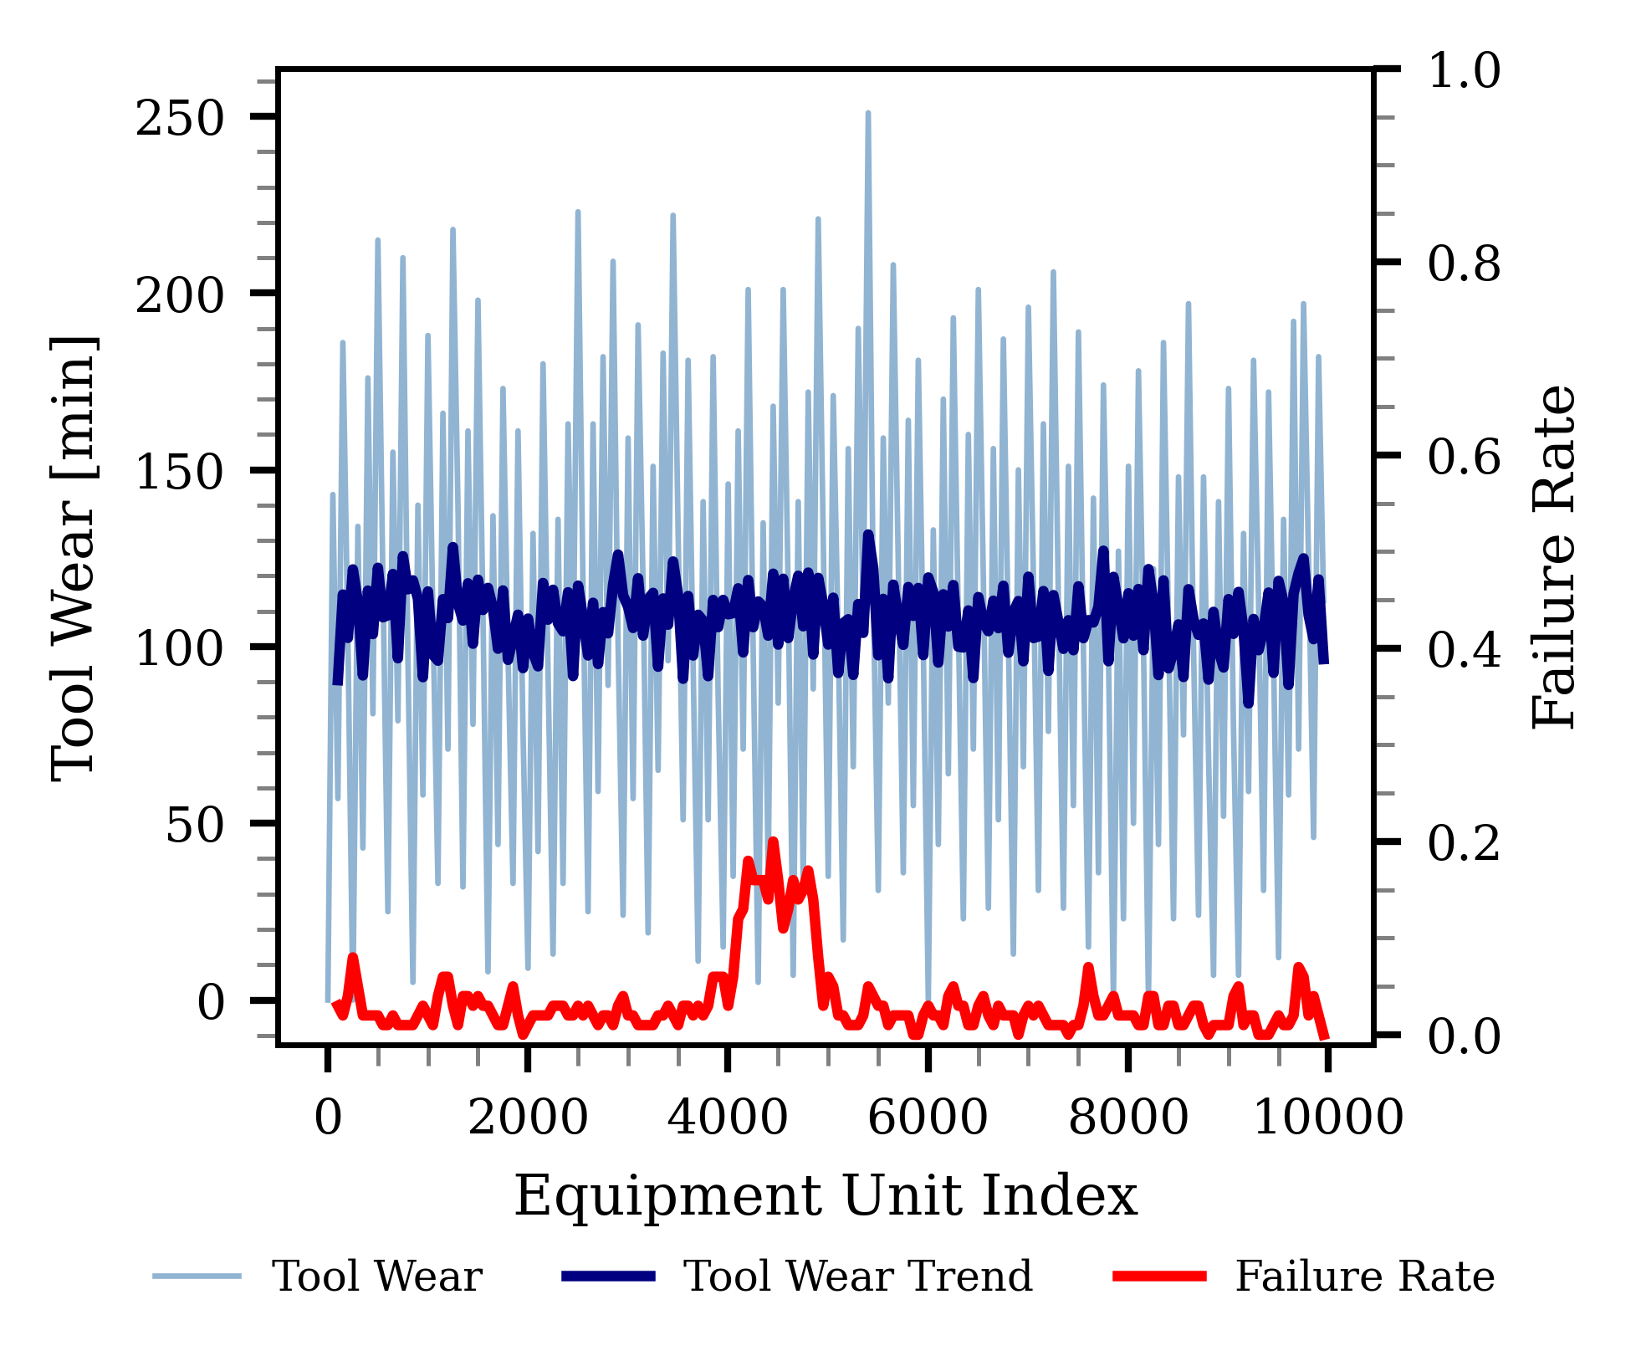
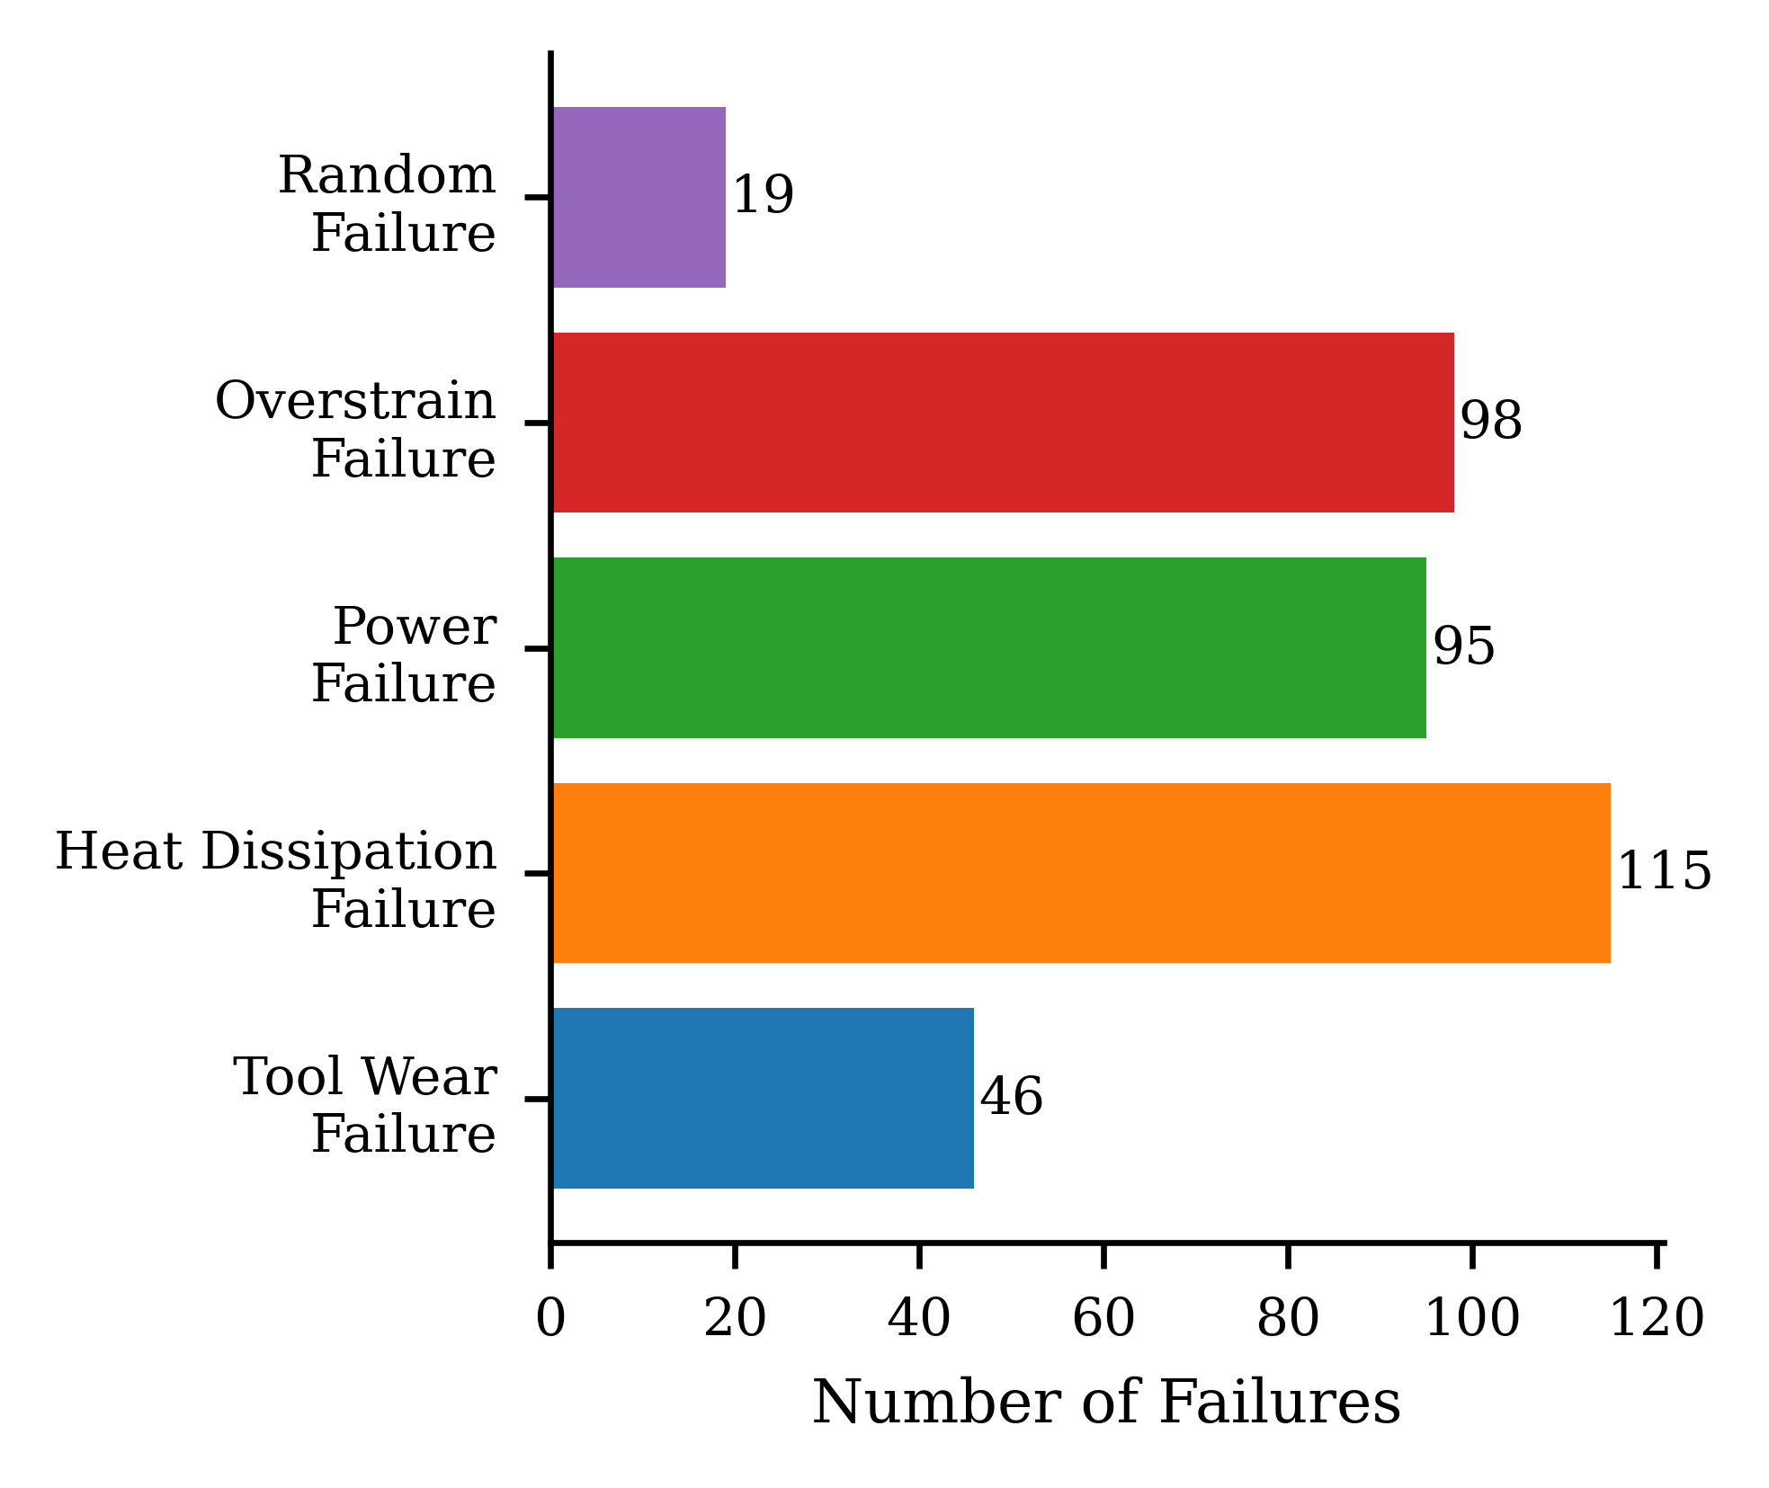

Slide 11
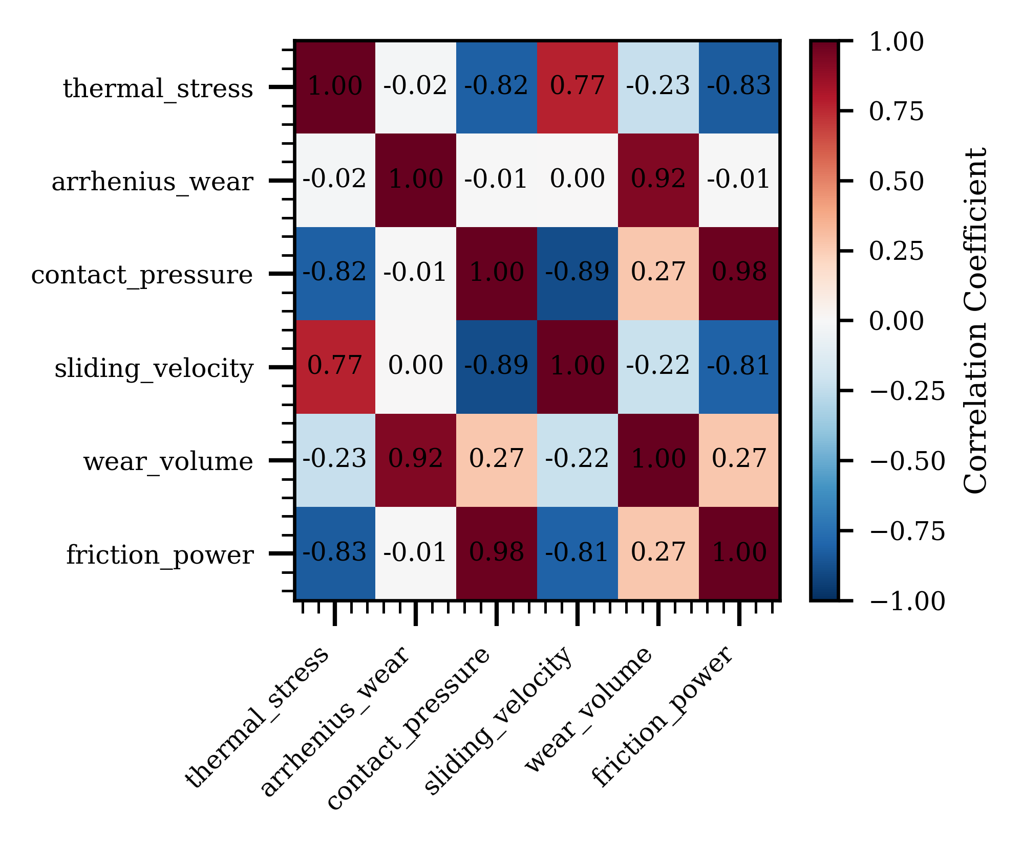
Thermal stress
Arhenius wear
Contact pressure
Correlation coefficient
Sliding velocity
Wear volume
Friction wear
Wear volume
Thermal stress
Friction wear
Arhenius wear
Sliding velocity
Contact pressure

Slide 12
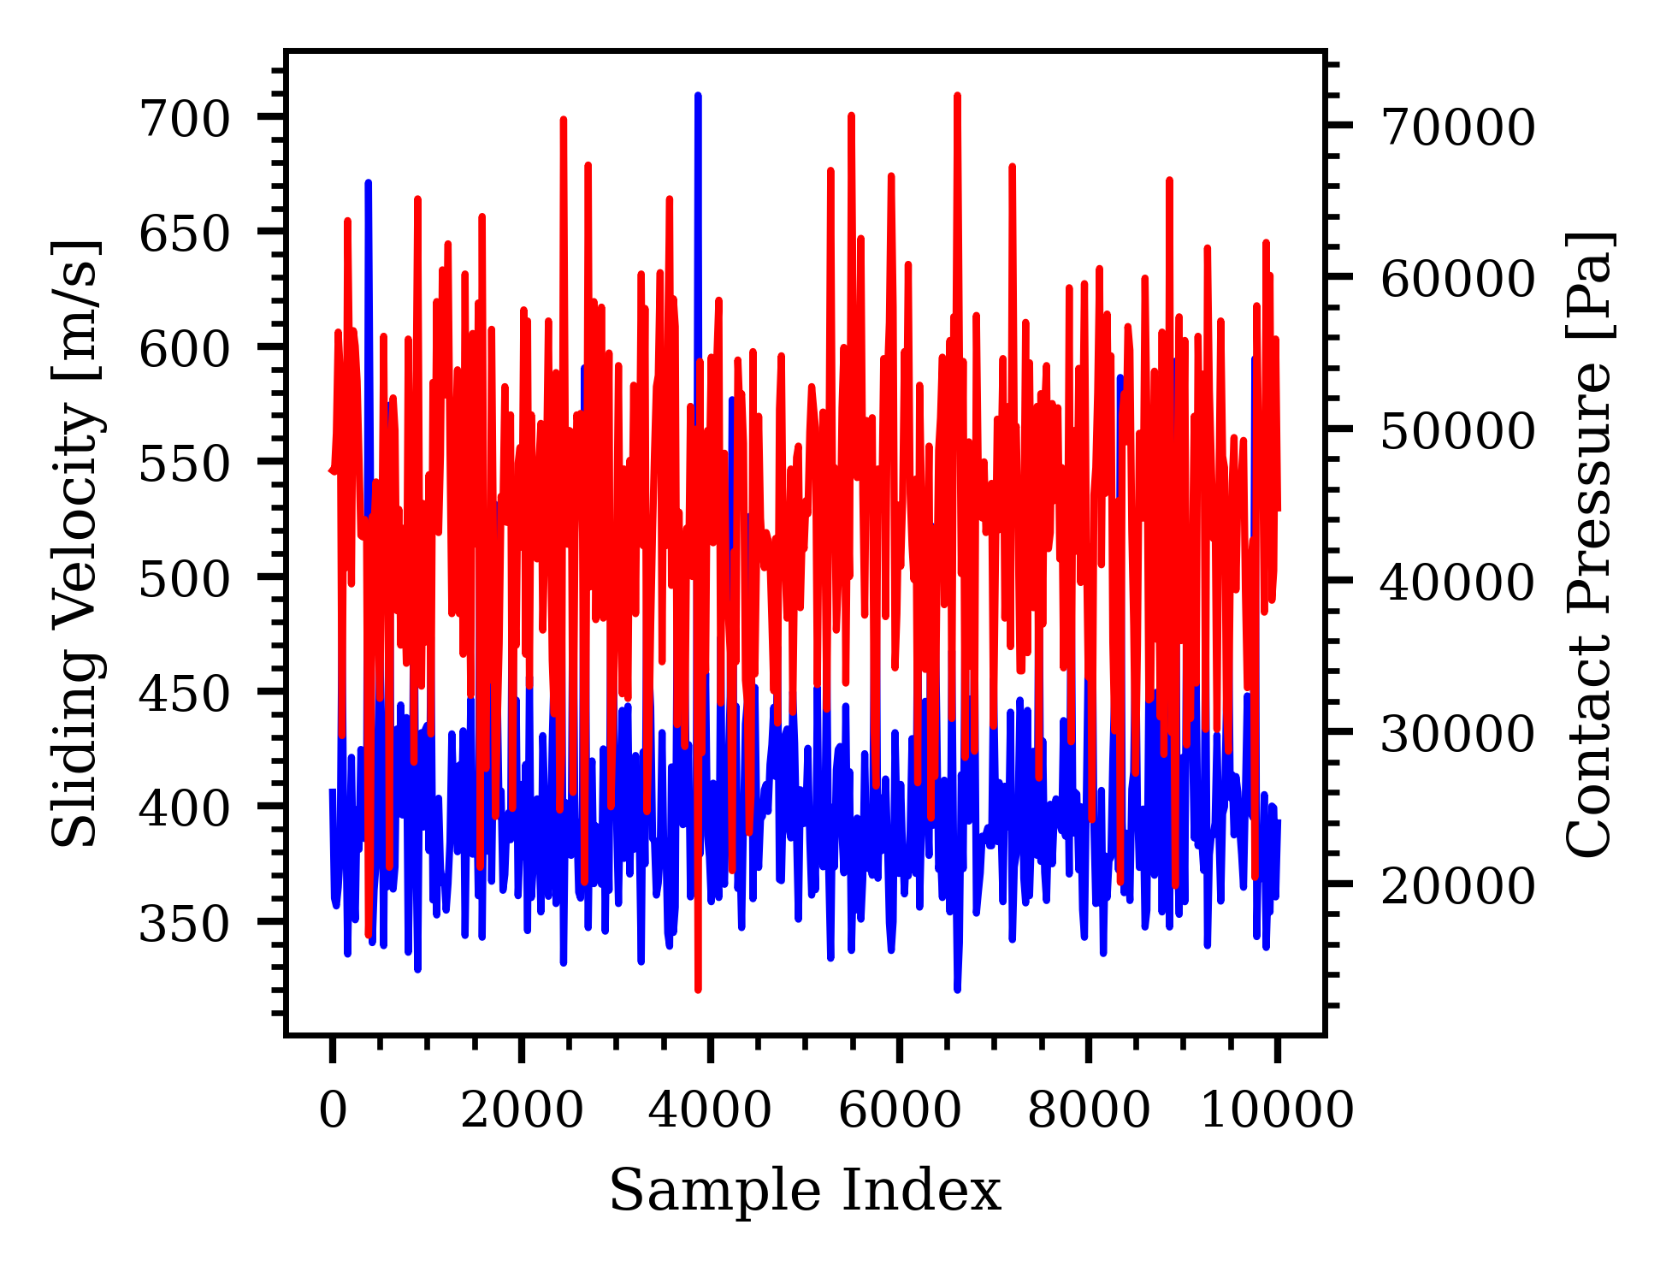
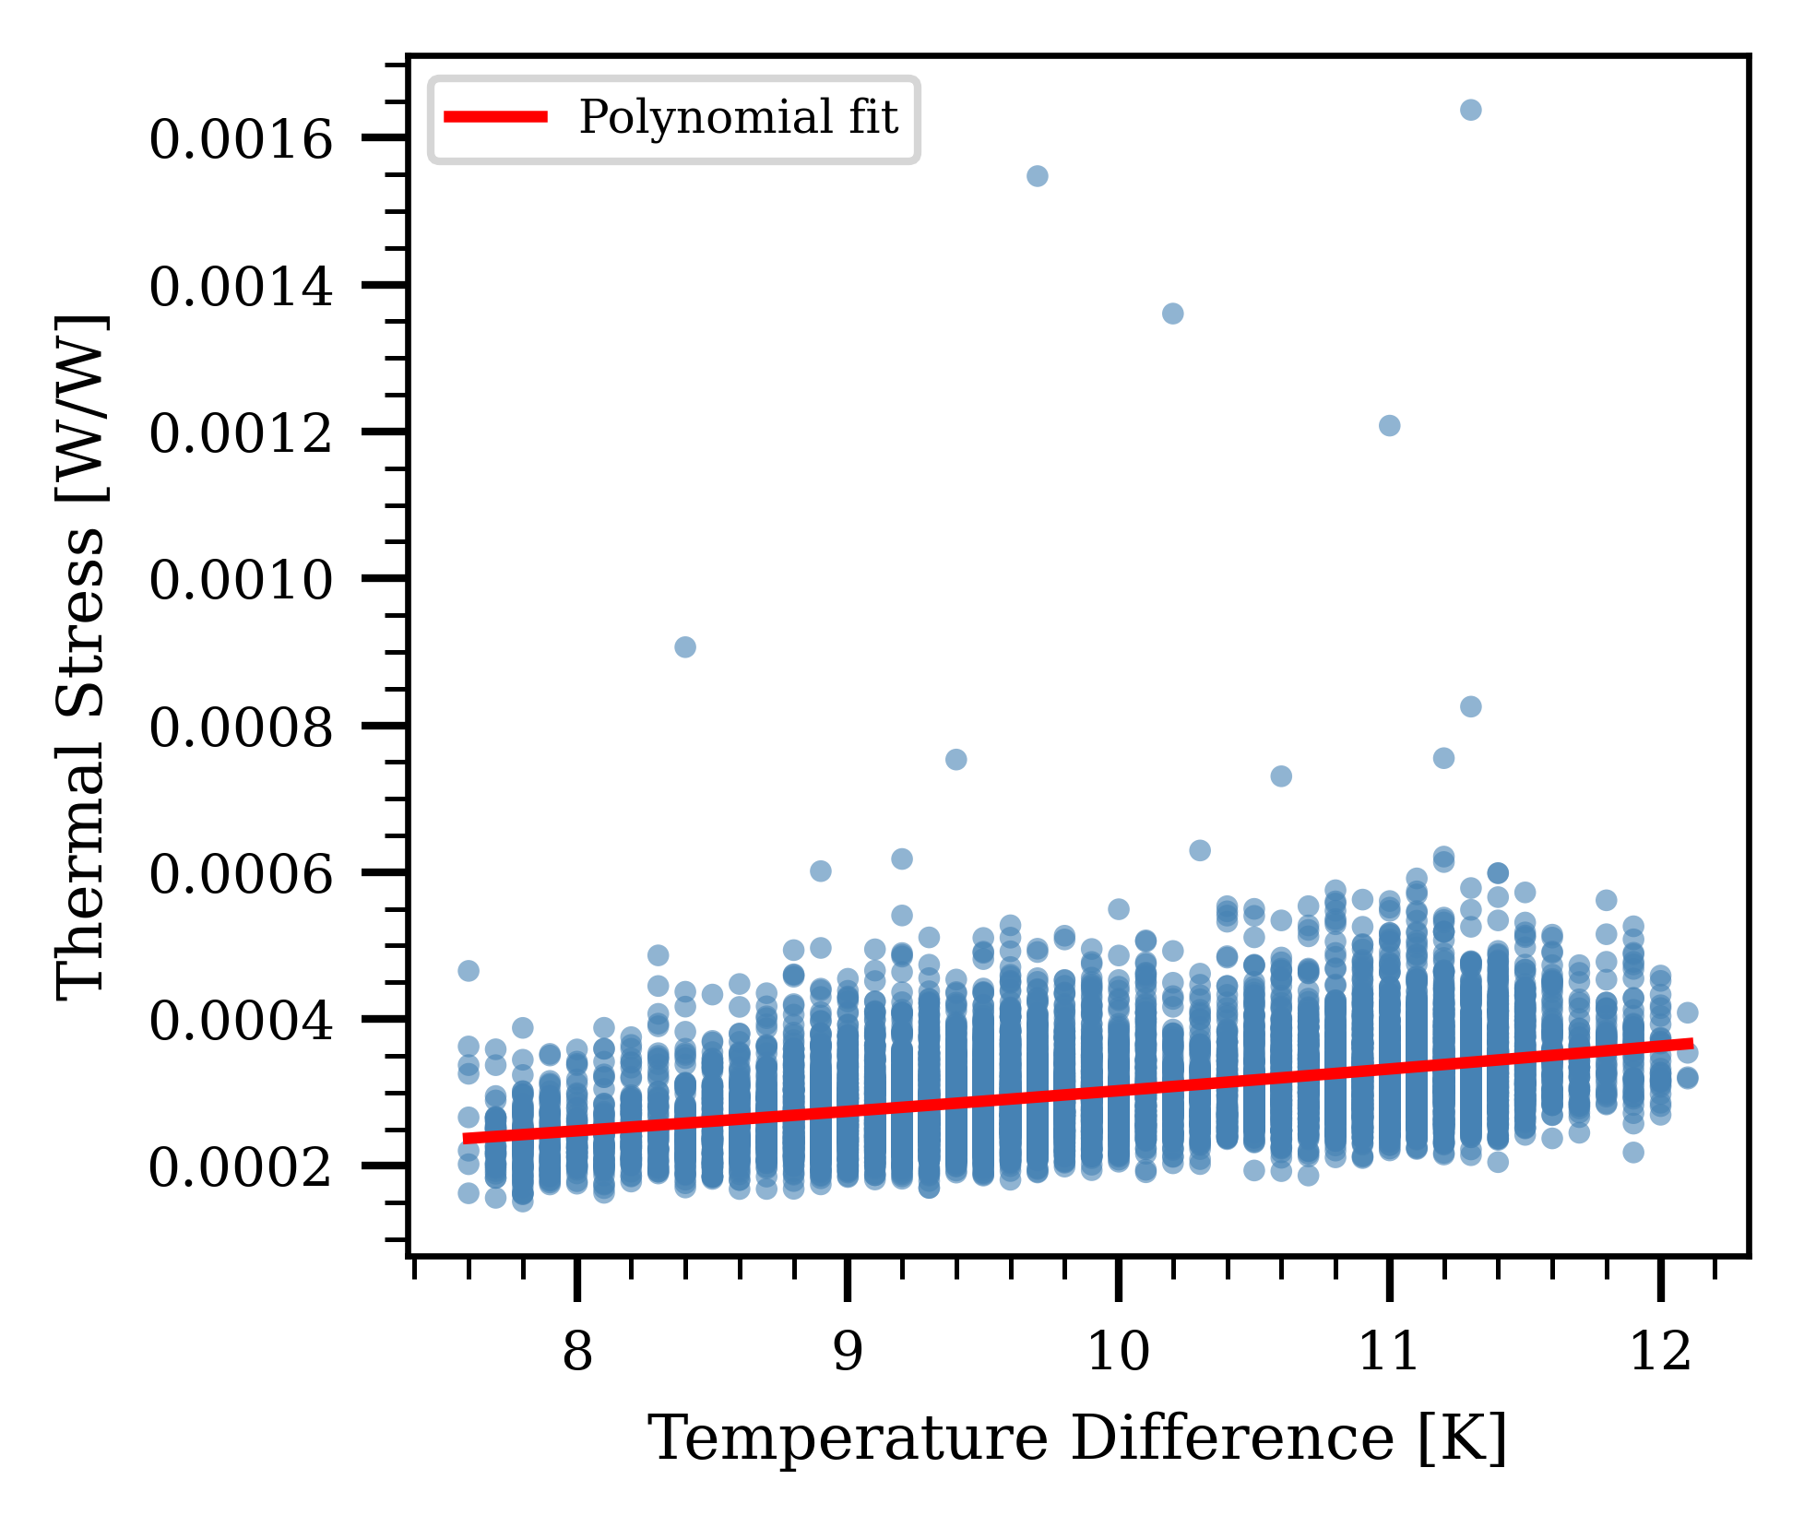
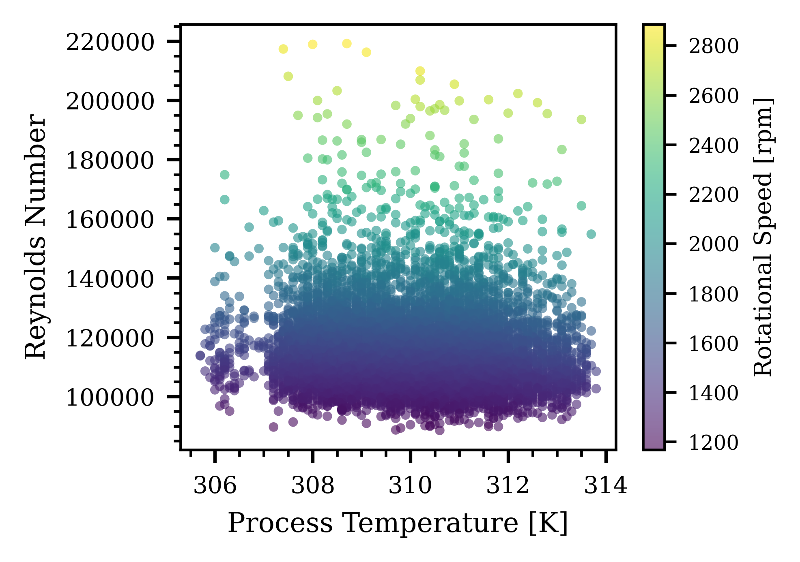
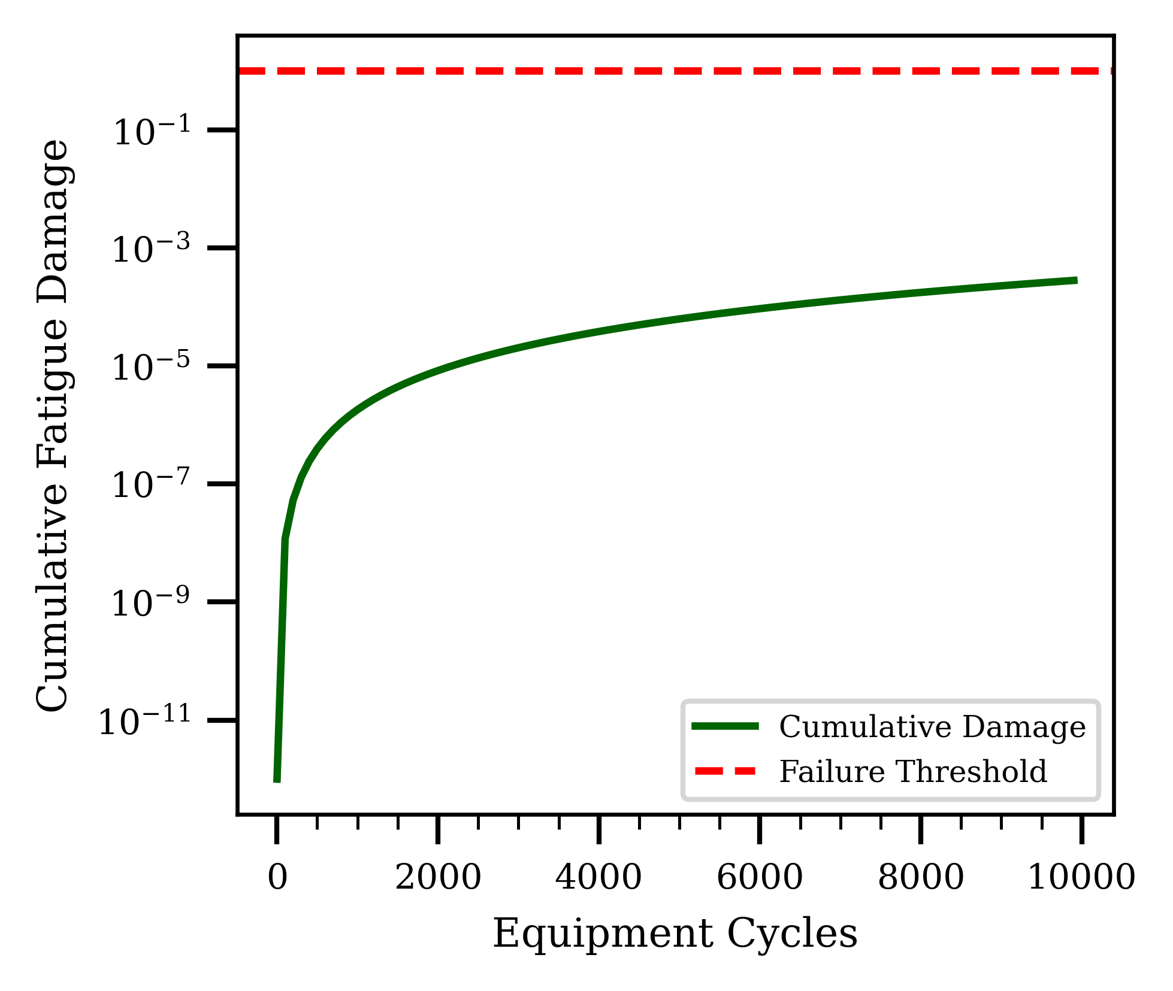
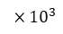
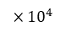
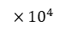
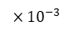
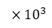
700
$${×10}^{4}$$
$${×10}^{−3}$$
700
7
16
650
6
14
600
5
12
550
Contact Pressure[Pa]
Thermal Stress[W/W]
Sliding velocity[m/s]
10
500
4
08
450
3
06
400
2
04
350
$${×10}^{3}$$
02
0
2
4
6
8
10
08
09
10
11
12
Sample Index
Temperature Difference[K]
Sliding Velocity Contact Pressure
$${×10}^{4}$$
$${×10}^{3}$$
22
28
20
26
$${10}^{−1}$$
18
24
$${10}^{−3}$$
Reynolds Number
22
16
Cumulative Fatigue Damage
$${10}^{−5}$$
Rotational Speed[rpm]
14
20
$${10}^{−7}$$
12
18
16
$${10}^{−9}$$
10
14
$${10}^{−11}$$
12
0
2
6
8
10
$${×10}^{3}$$
306
308
310
312
314
12
Process Temperature[K]
Equipment Cycles

Slide 13
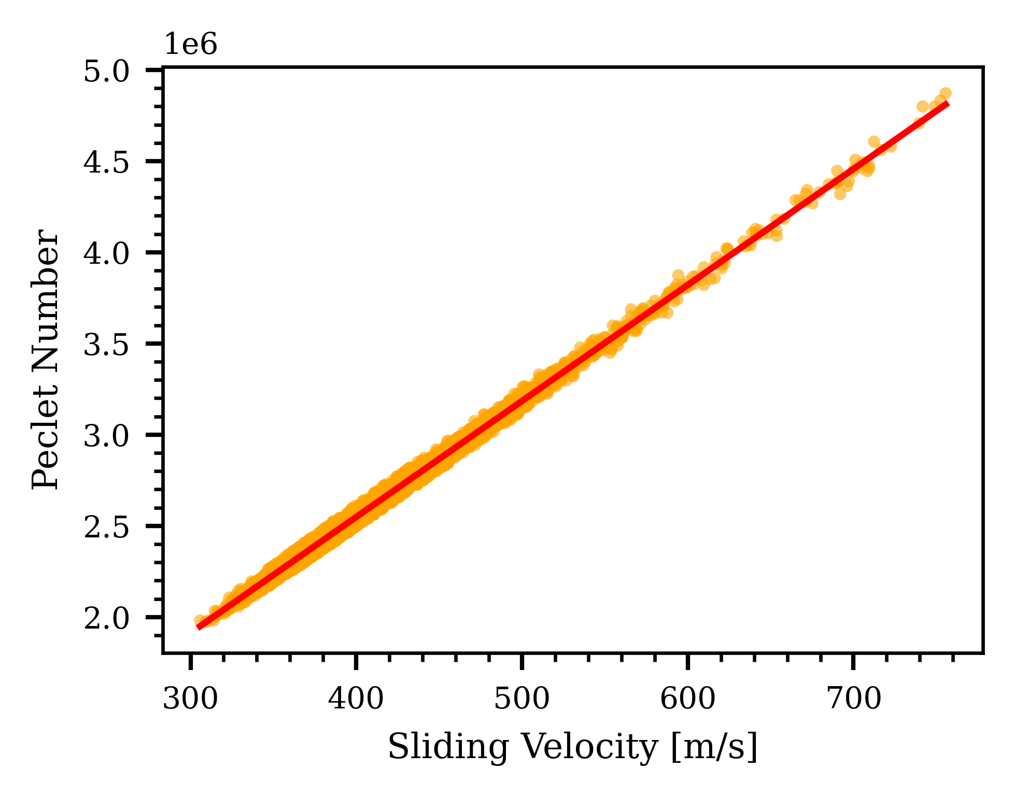
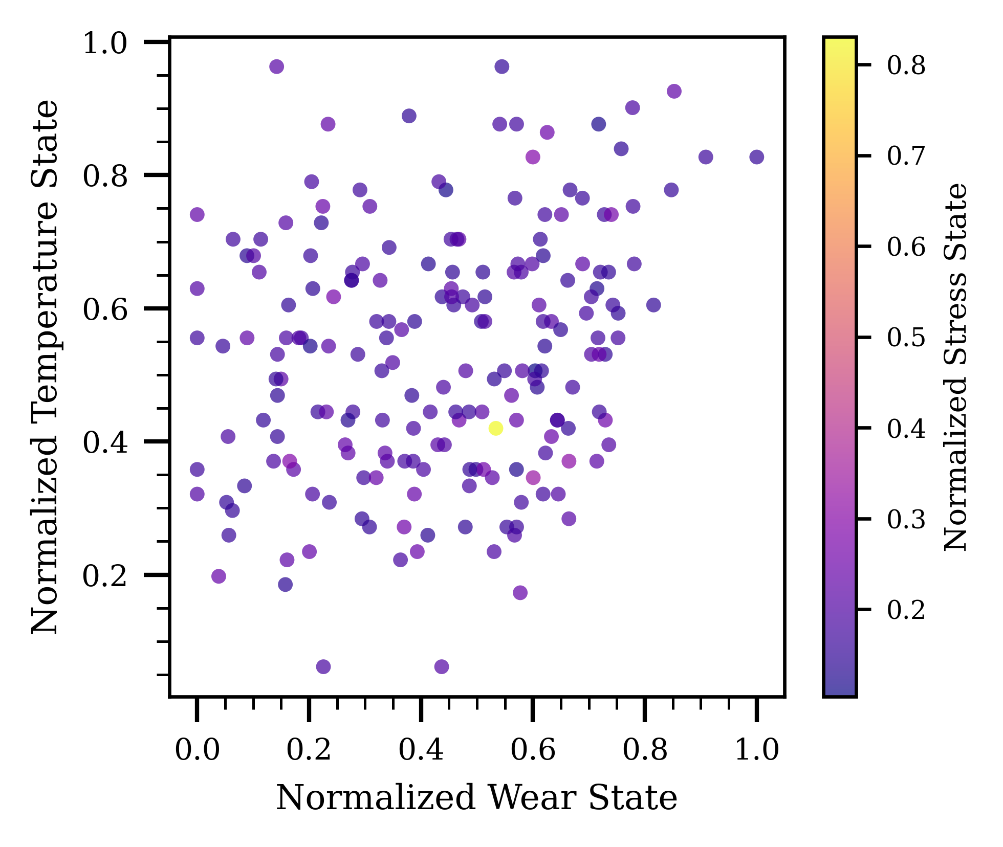
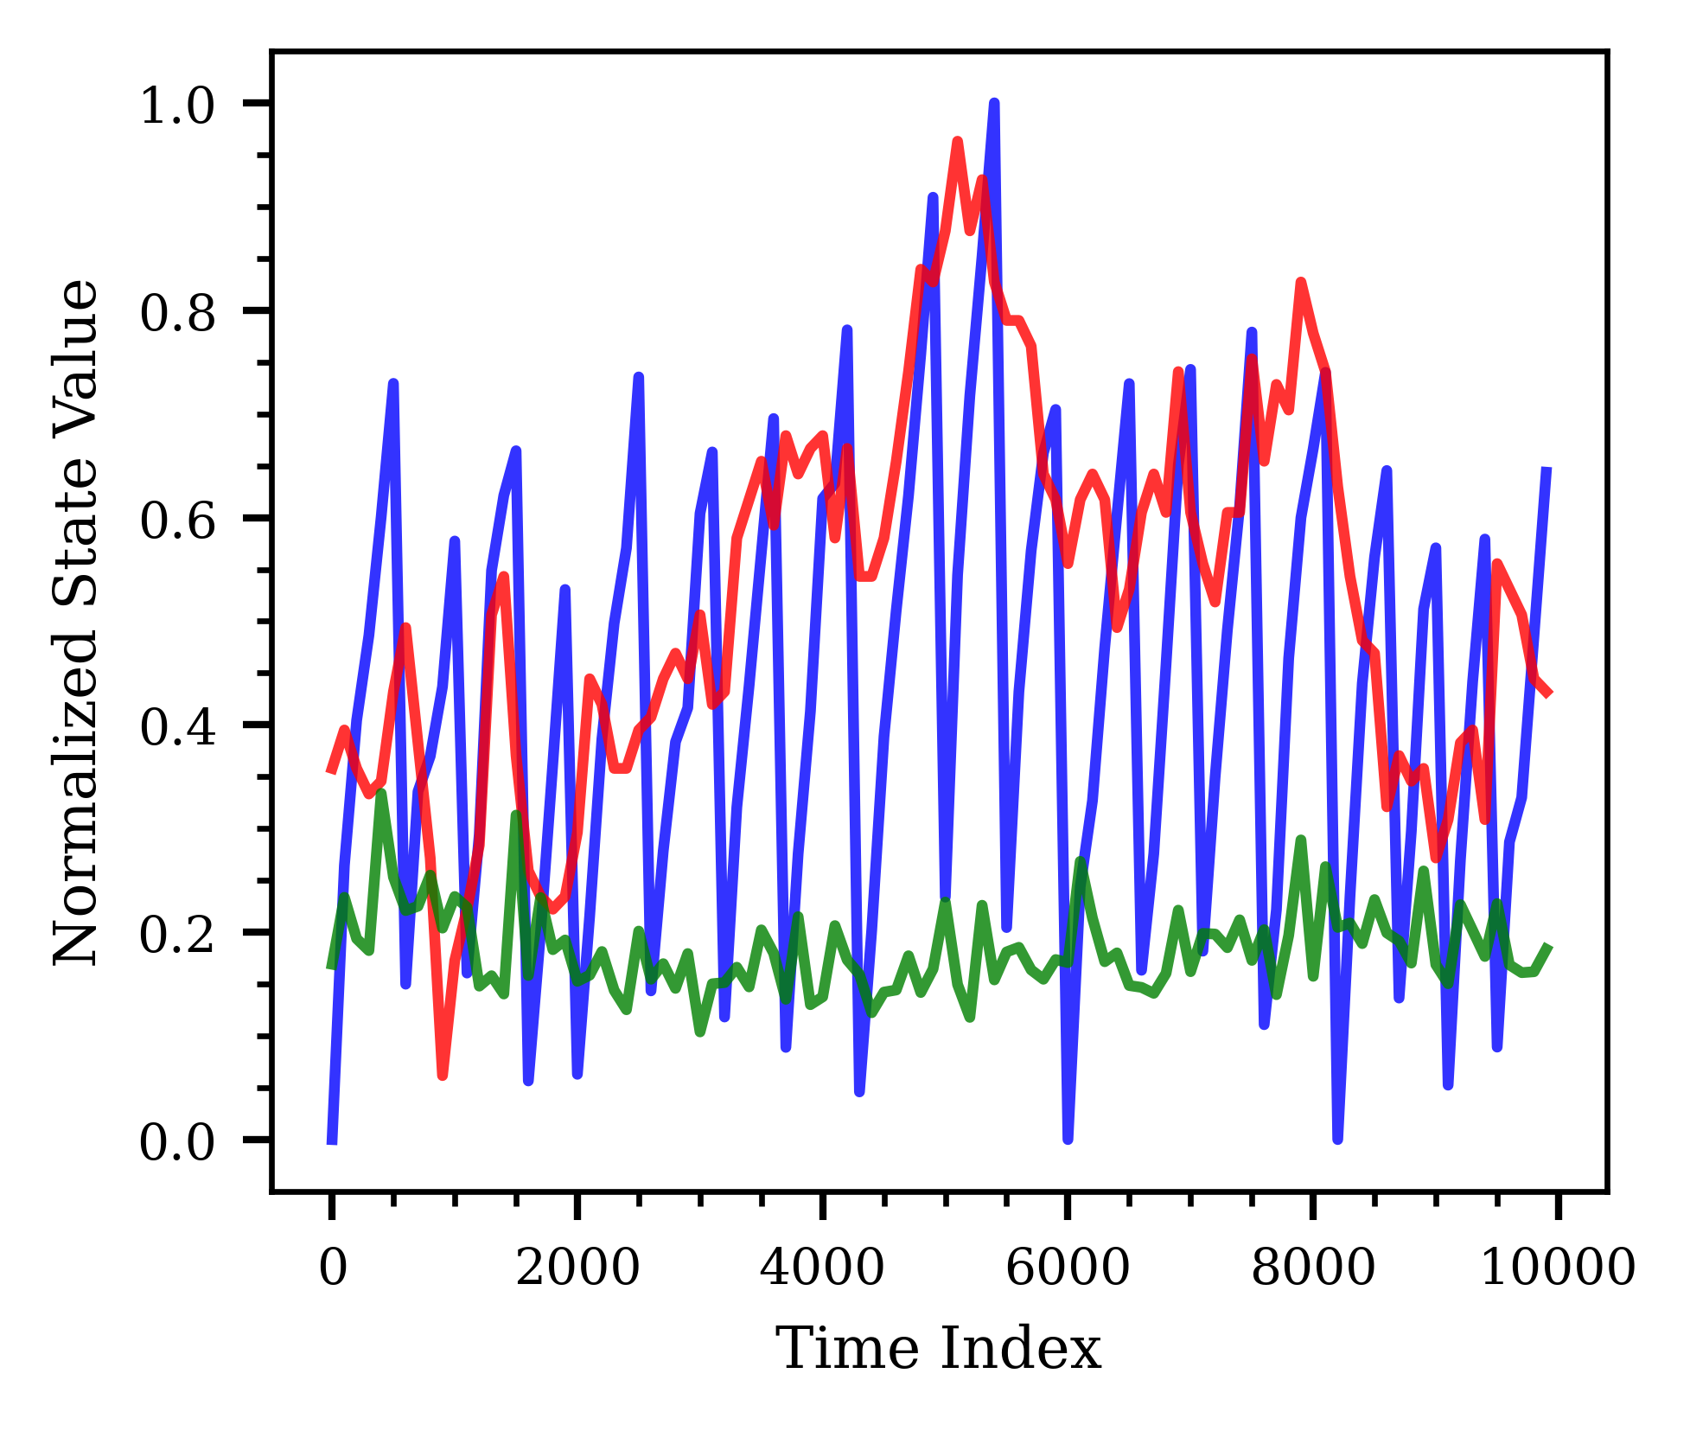
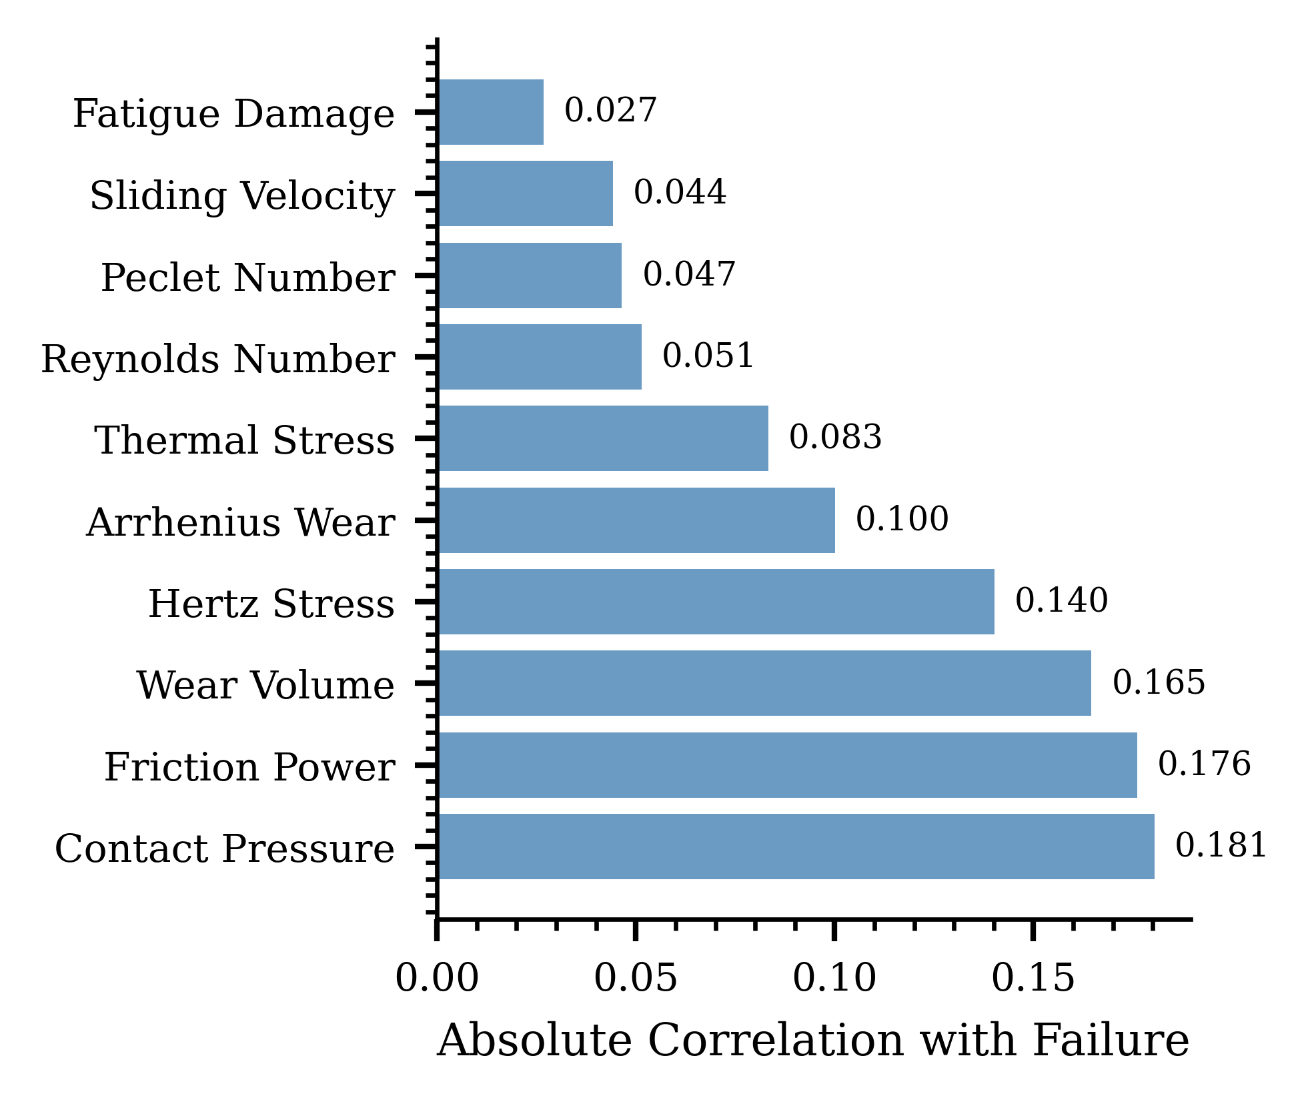
Wear state
Stress state
Wear state

Slide 14
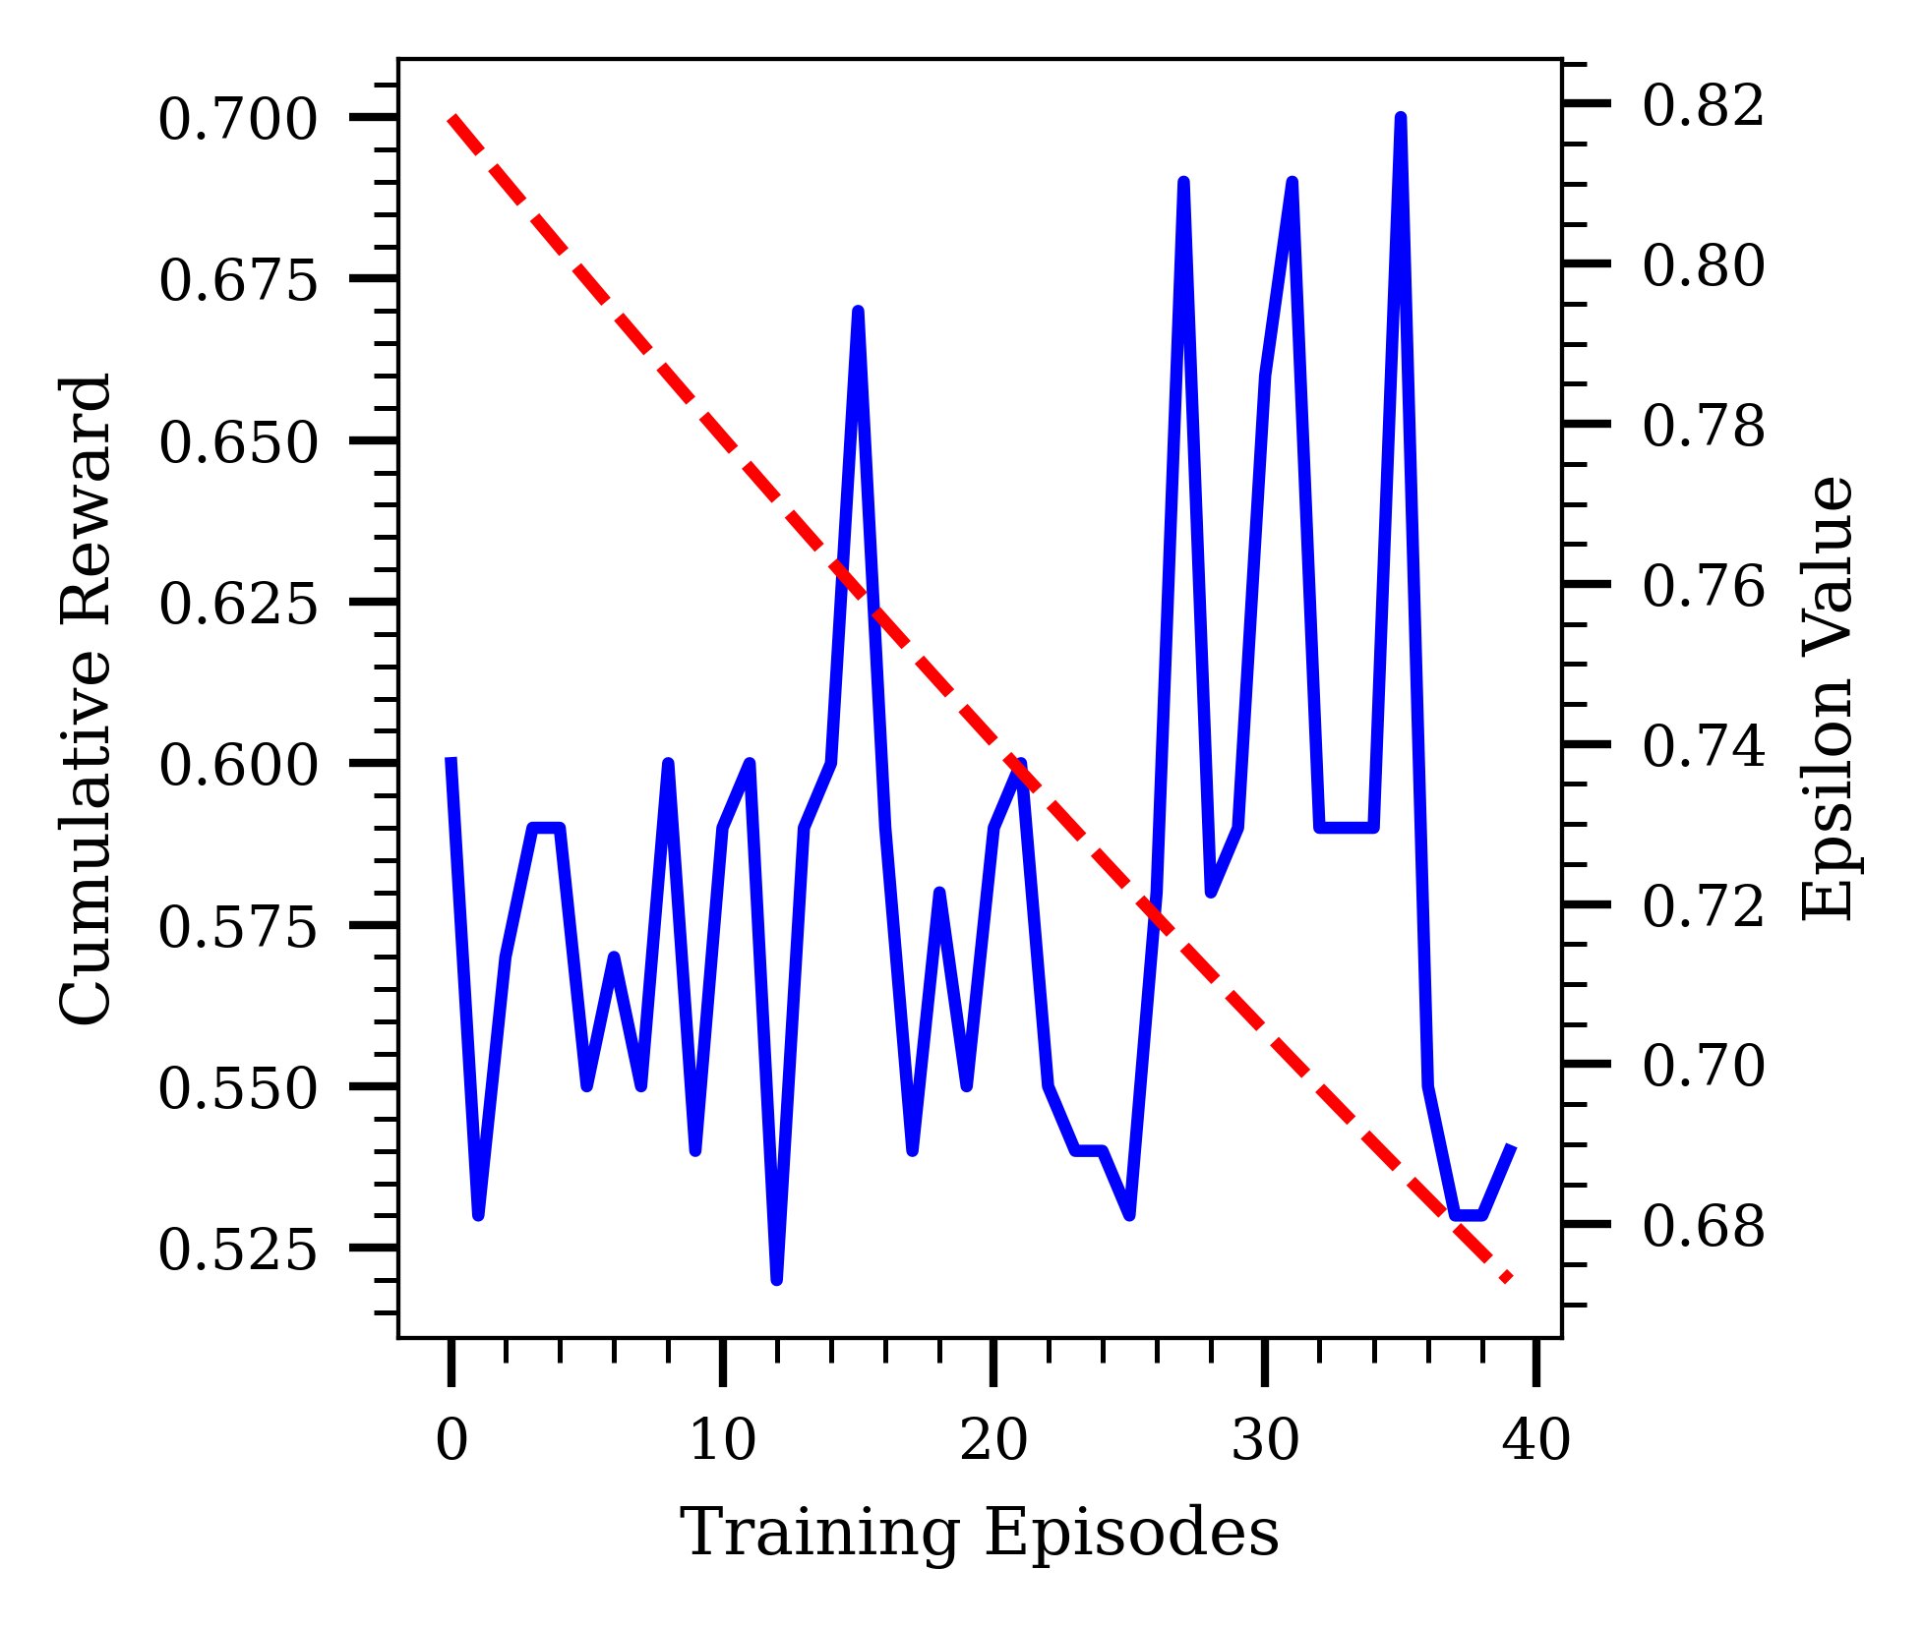
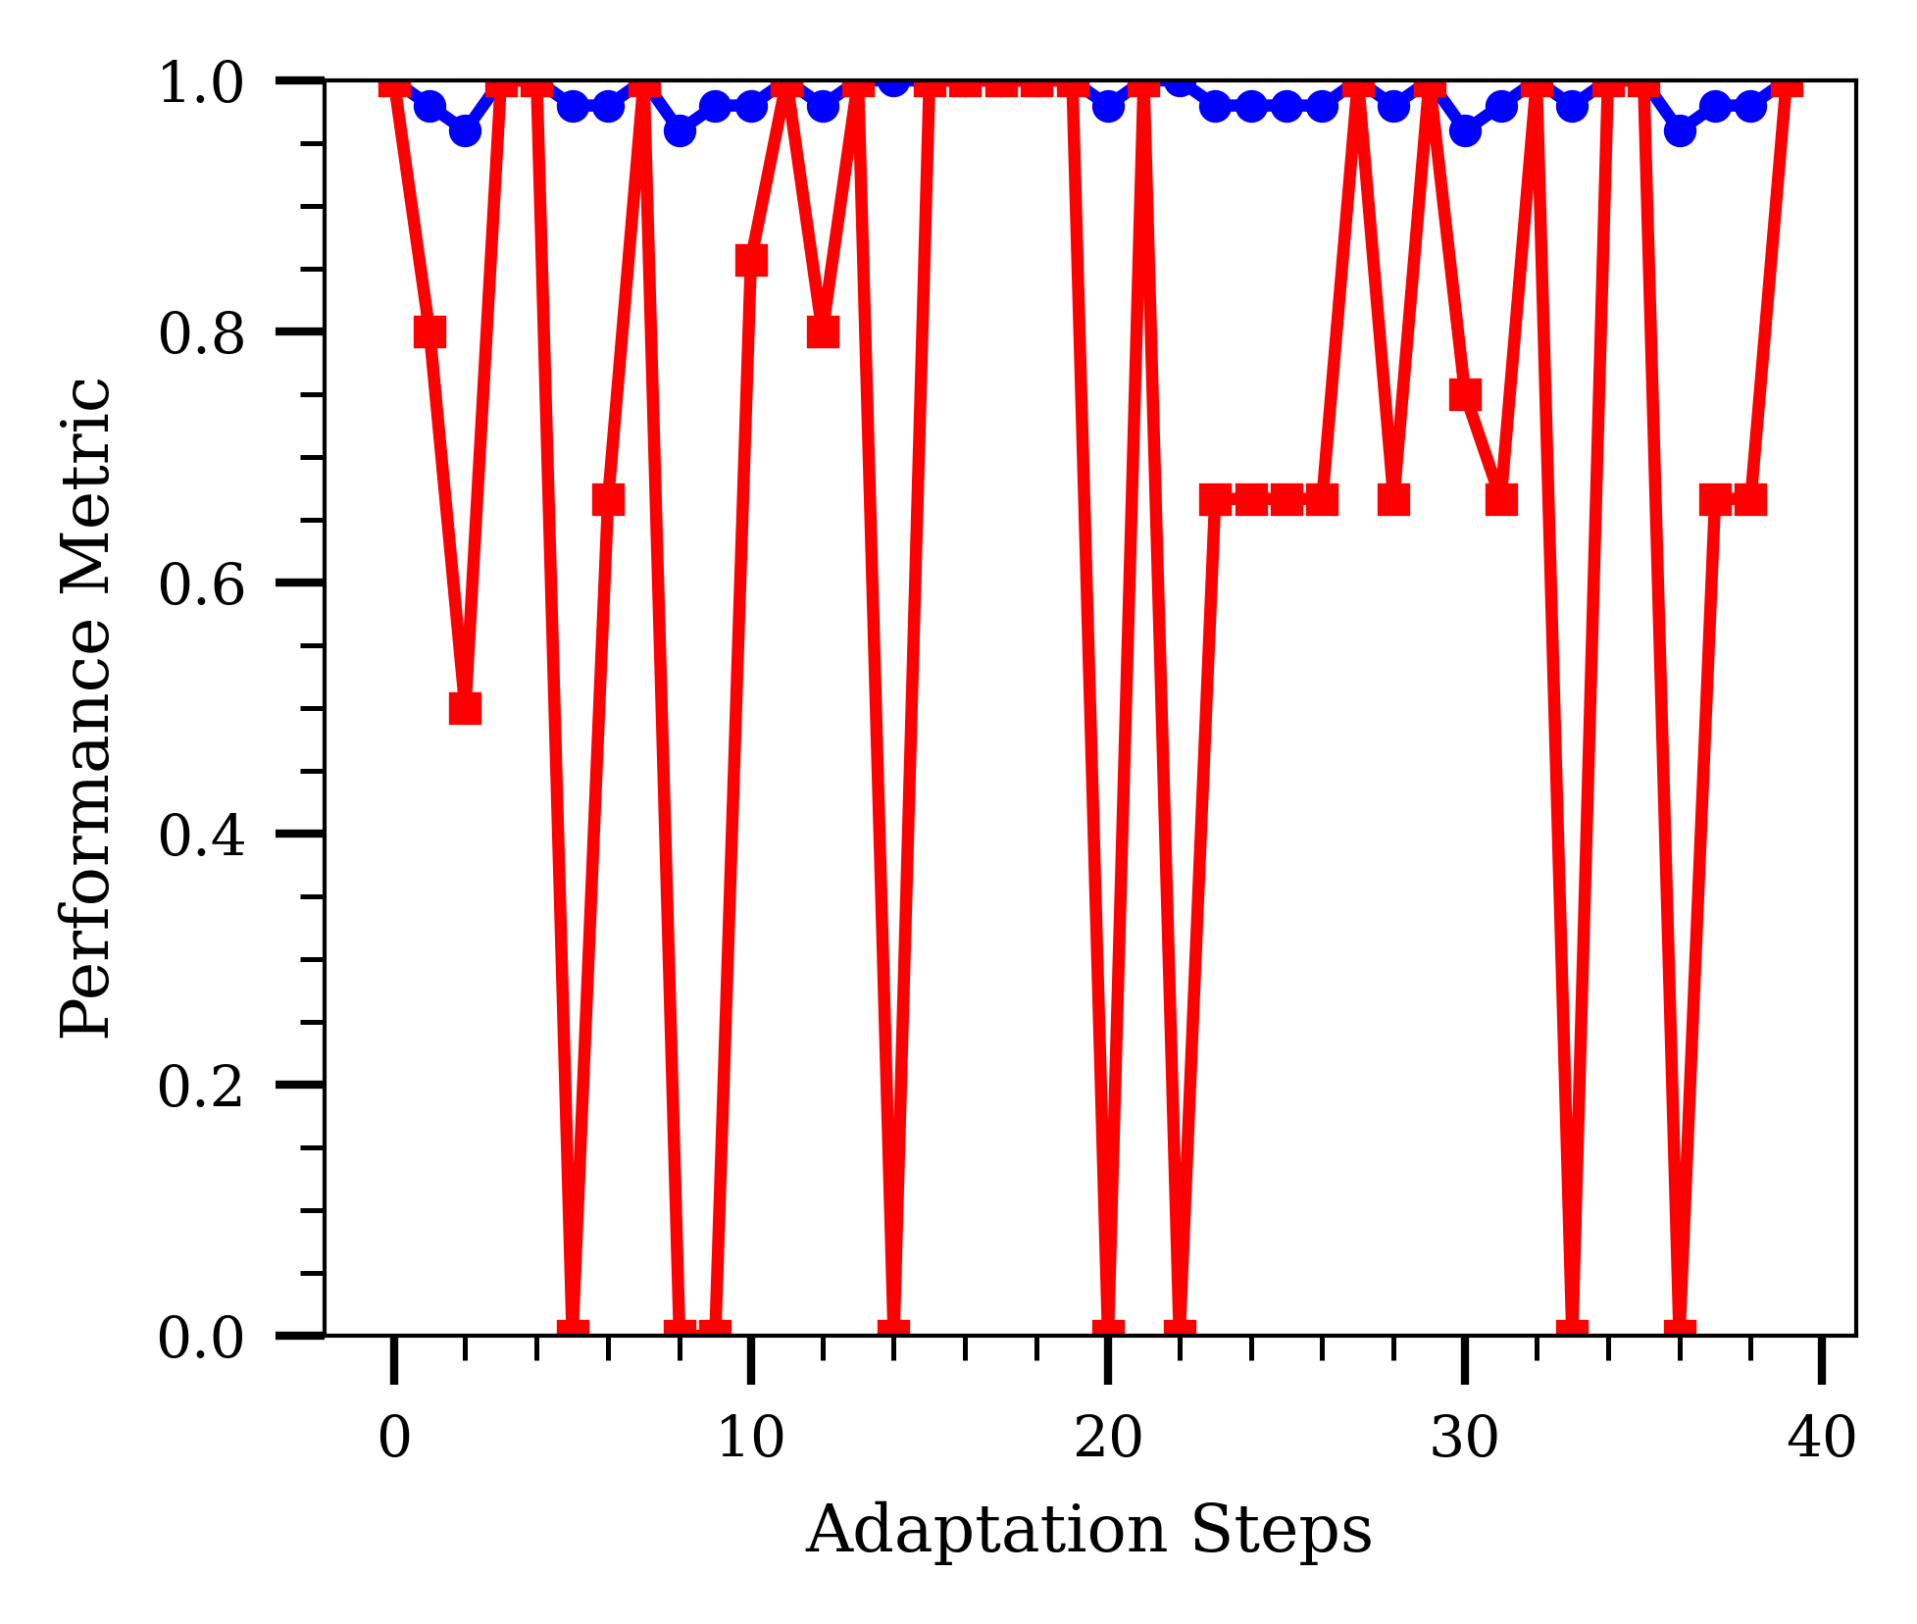
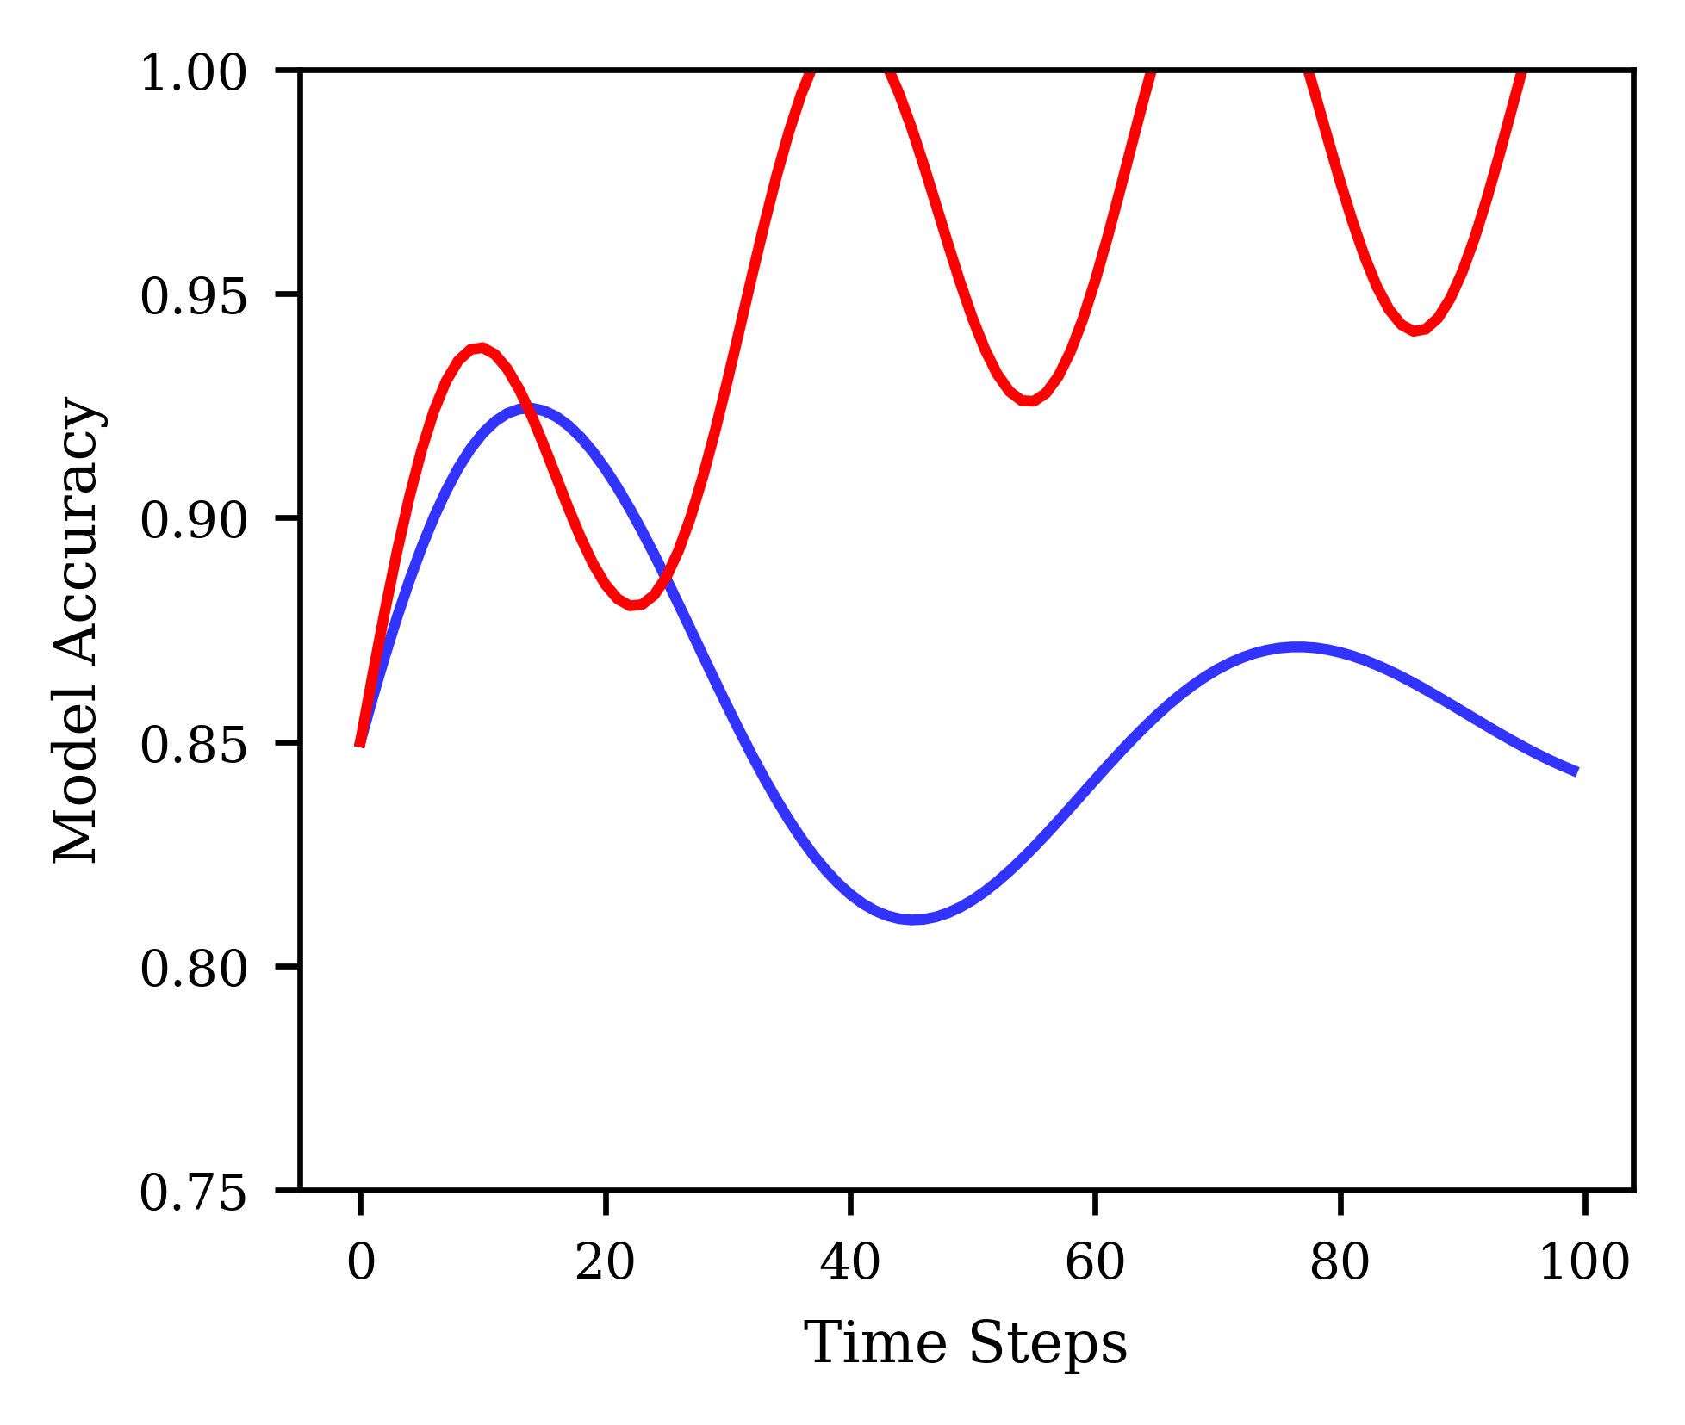
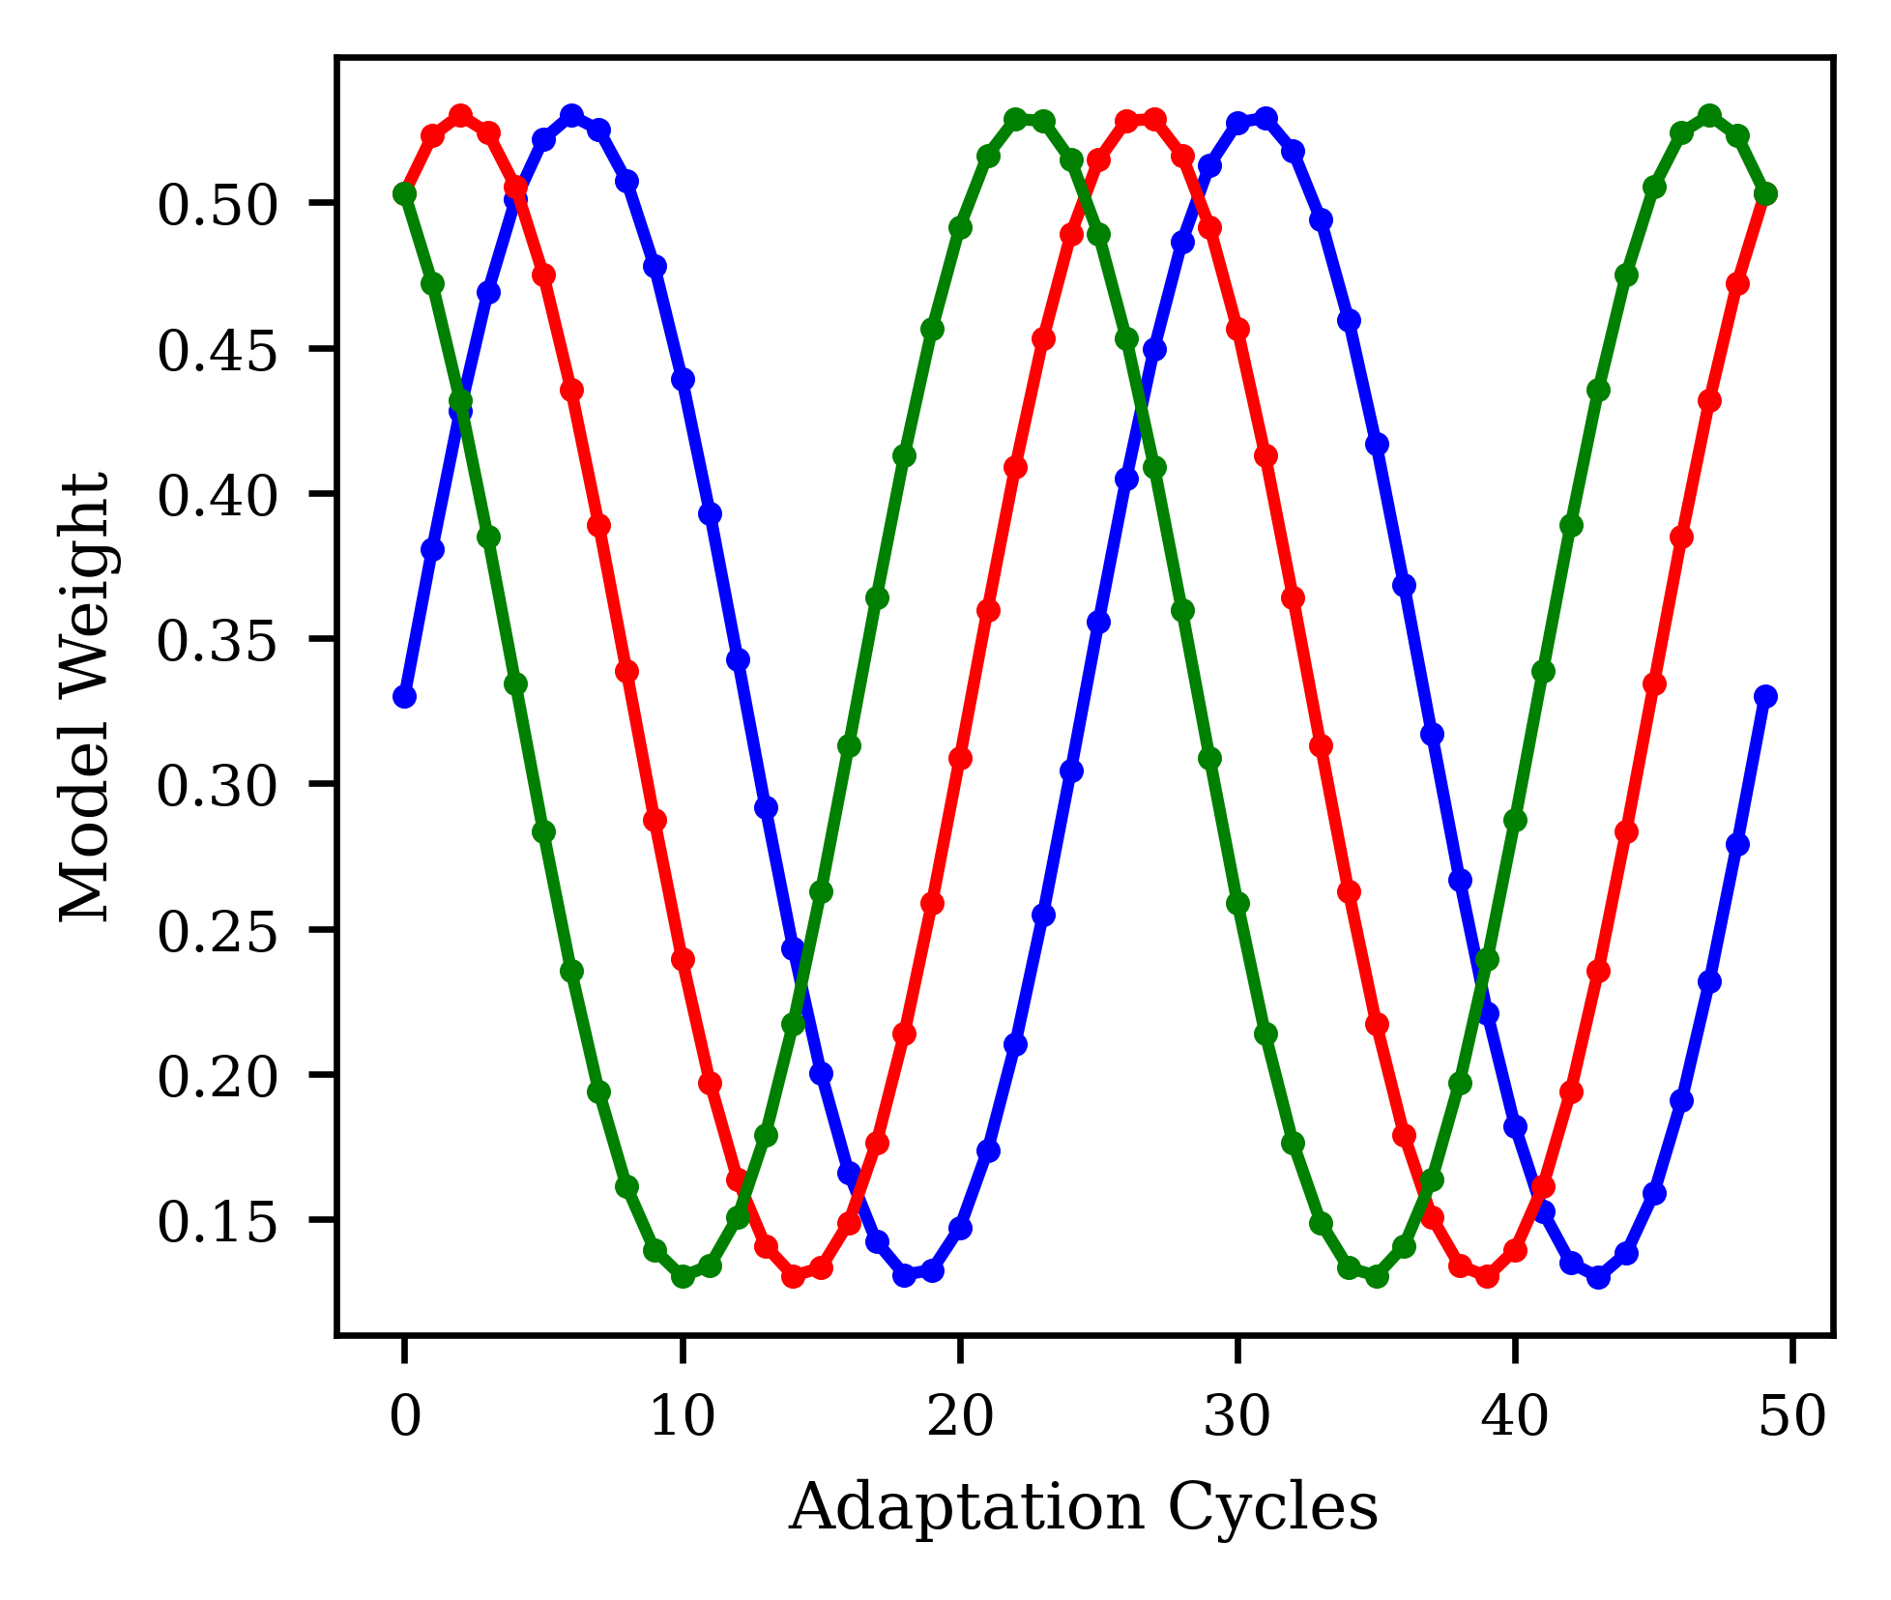
0.700
0.82
1.0
0.675
0.80
0.8
0.78
0.650
Epsilon Value
0.6
0.625
0.76
Cumulative Reward
Performance Metric
0.600
0.74
0.4
0.575
0.72
0.550
0.70
0.2
0.525
0.68
0.0
0
10
20
30
40
0.0
10
20
30
40
Training Episodes
Adaptation Steps
Actual Reward Epsilon Decay
1.00
0.50
0.95
0.45
0.40
Model Accuracy
Model Weight
0.90
0.35
0.85
0.30
0.25
0.80
0.20
0.75
0.15
0
20
30
40
50
60
0
10
20
30
40
50
Time Steps
Adaptation Cycles
Traditional Model
Self Adaptive Model
Random Forest
MLP
Adaptive NN

Slide 15
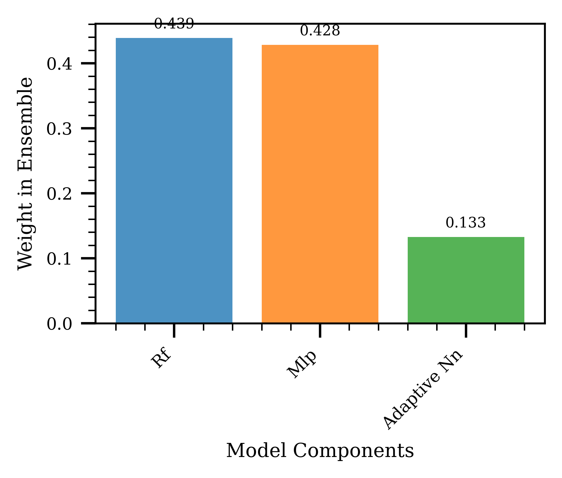
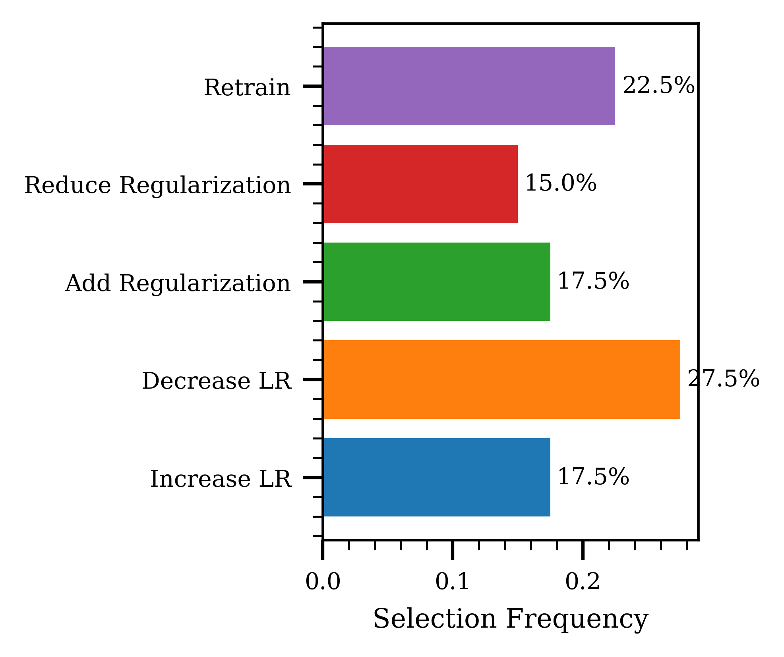
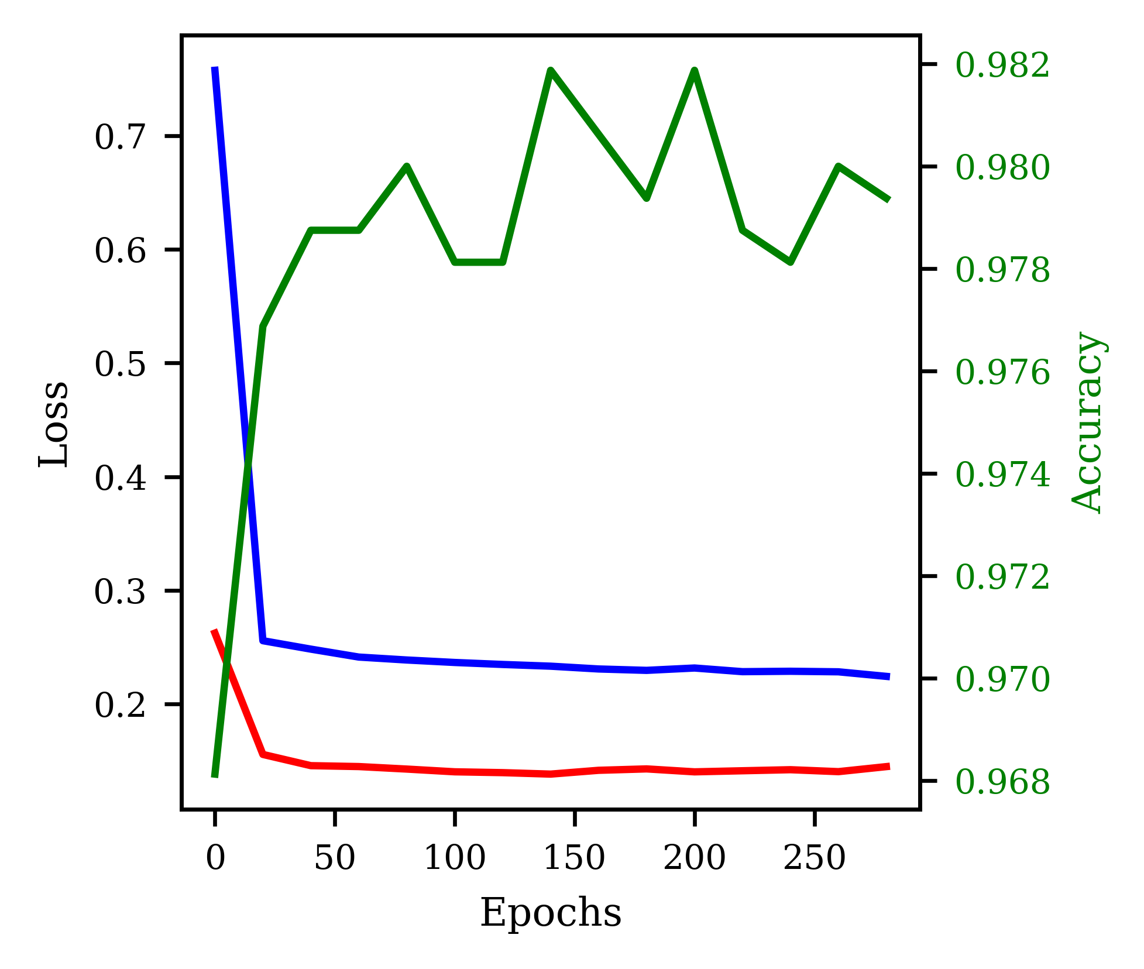
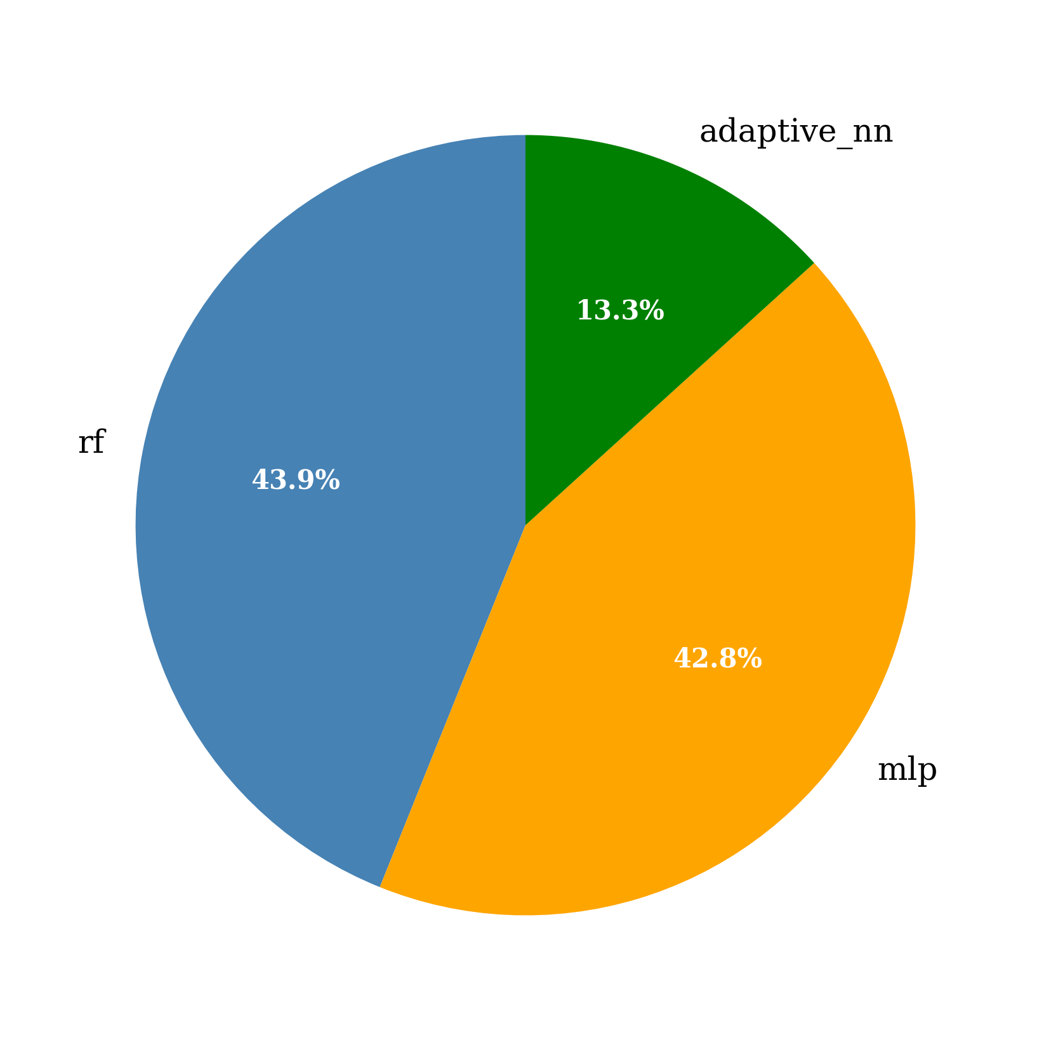
0.4
0.439
Retrain
22.5%
0.3
0.428
Reduce Regularization
15.0%
Weight Ensemble
Add Regularization
17.5%
0.2
0.1
Decrease Learning Rate
27.5%
0.133
Increase Learning Rate
17.5%
0.0
Random Forest (RF)
Multilayer Perceptron (MLP)
Adaptive Neural Network(NN)
0.0
0.1
0.2
0.3
Selection Frequency
0.982
Adaptive Neural Network
0.7
0.980
13.3
0.6
0.978
Random
Forest
0.5
0.976
Loss
Accuracy
43.9
0.4
0.974
0.3
0.972
42.8
0.2
0.970
Multilayer
Perceptron
0
50
100
150
200
250
0.968
Epochs

Slide 16
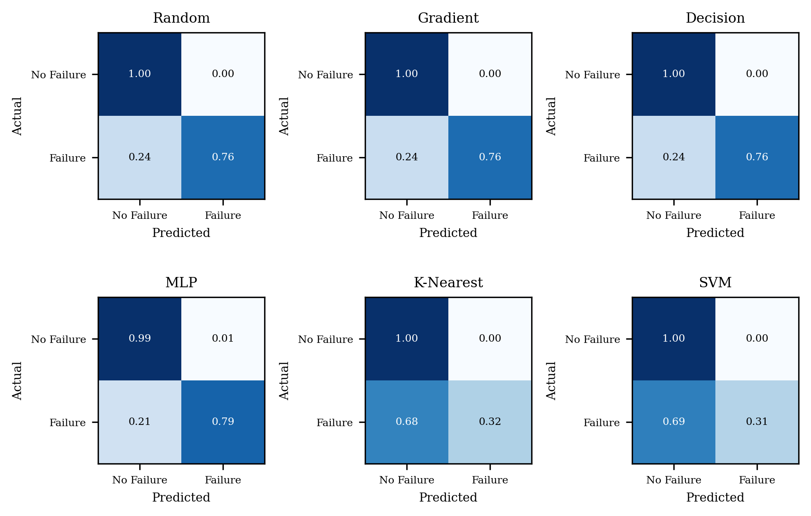

Slide 17
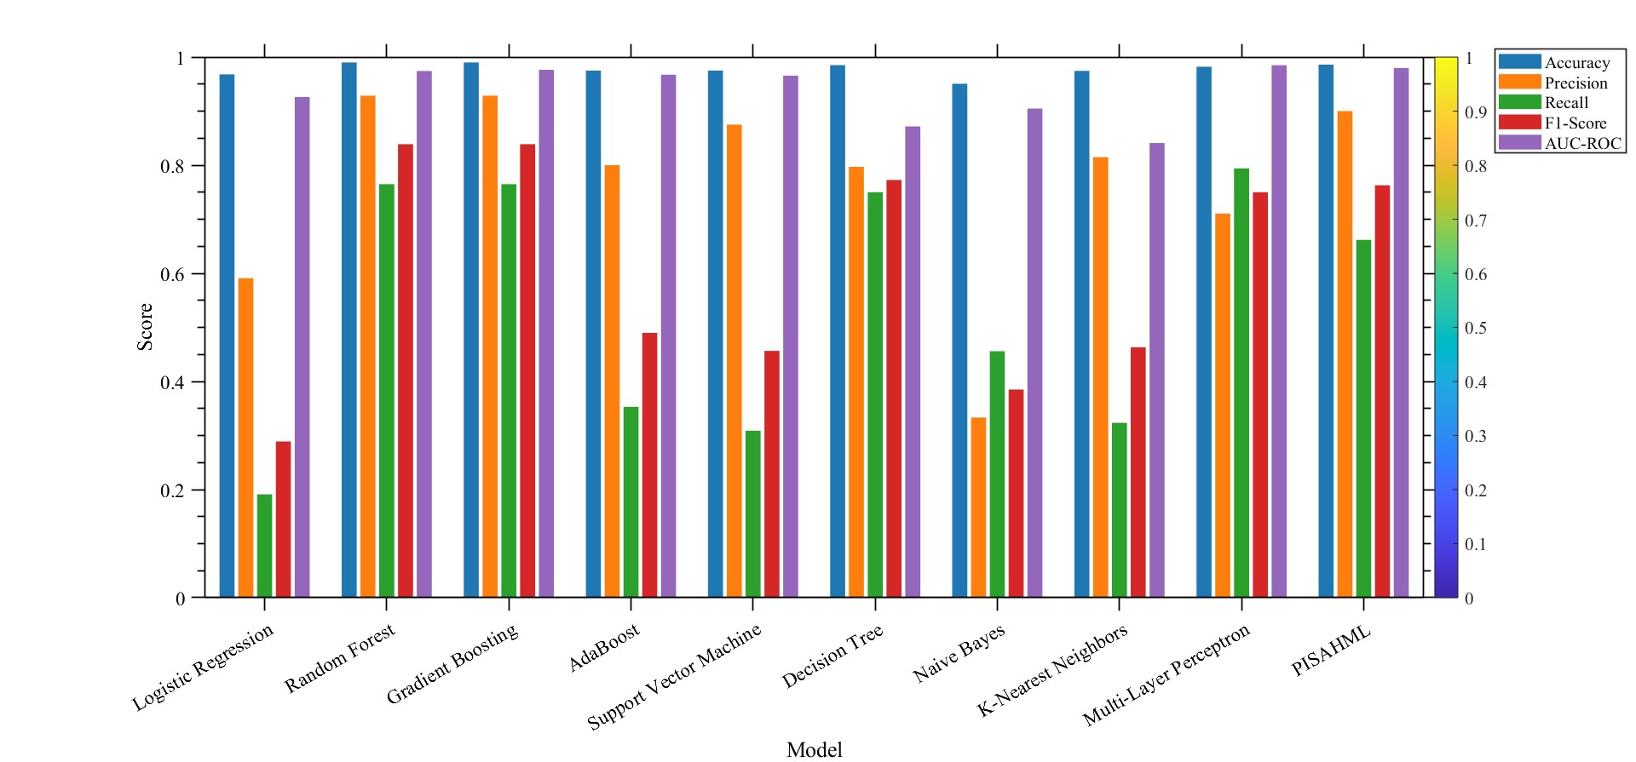
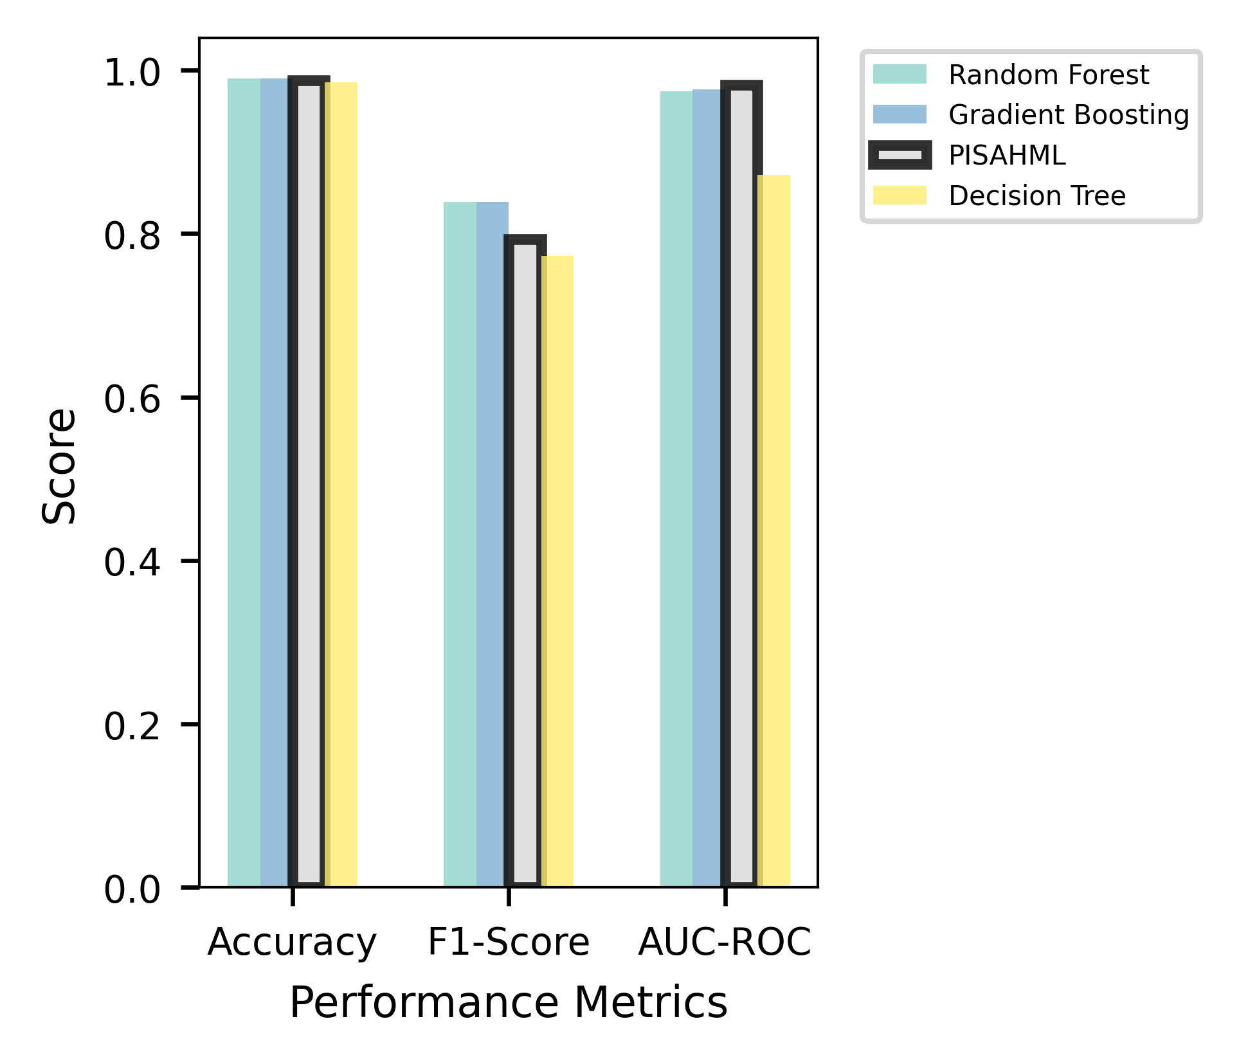
1.0
0.8
0.6
Score
0.4
0.2
0.0
Accuracy
F1 Score
AUC-ROC
Performance Metrics
Random Forest Gradient Boosting PISAHML Decision Tree

Slide 18
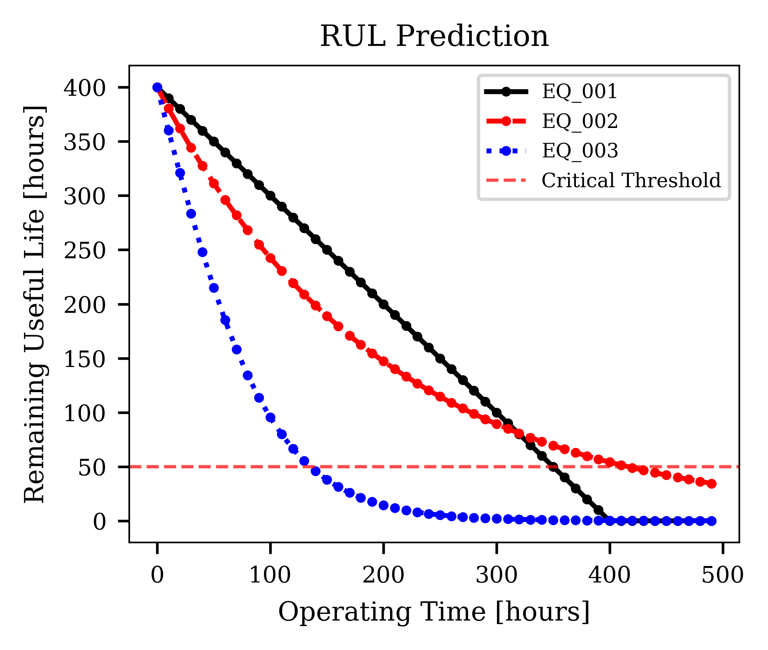
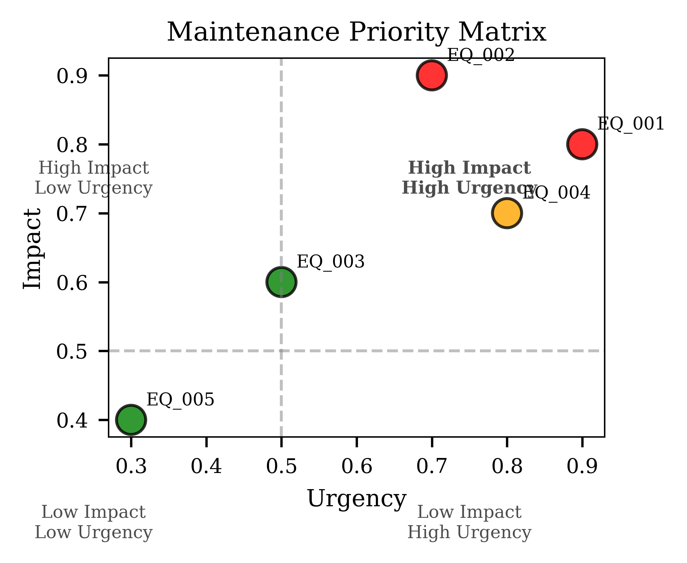
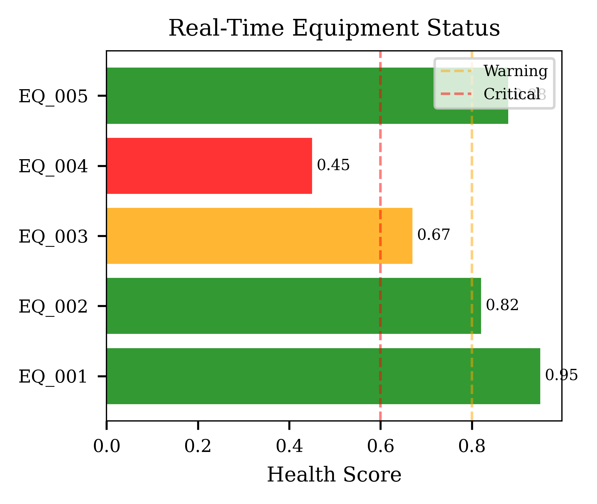
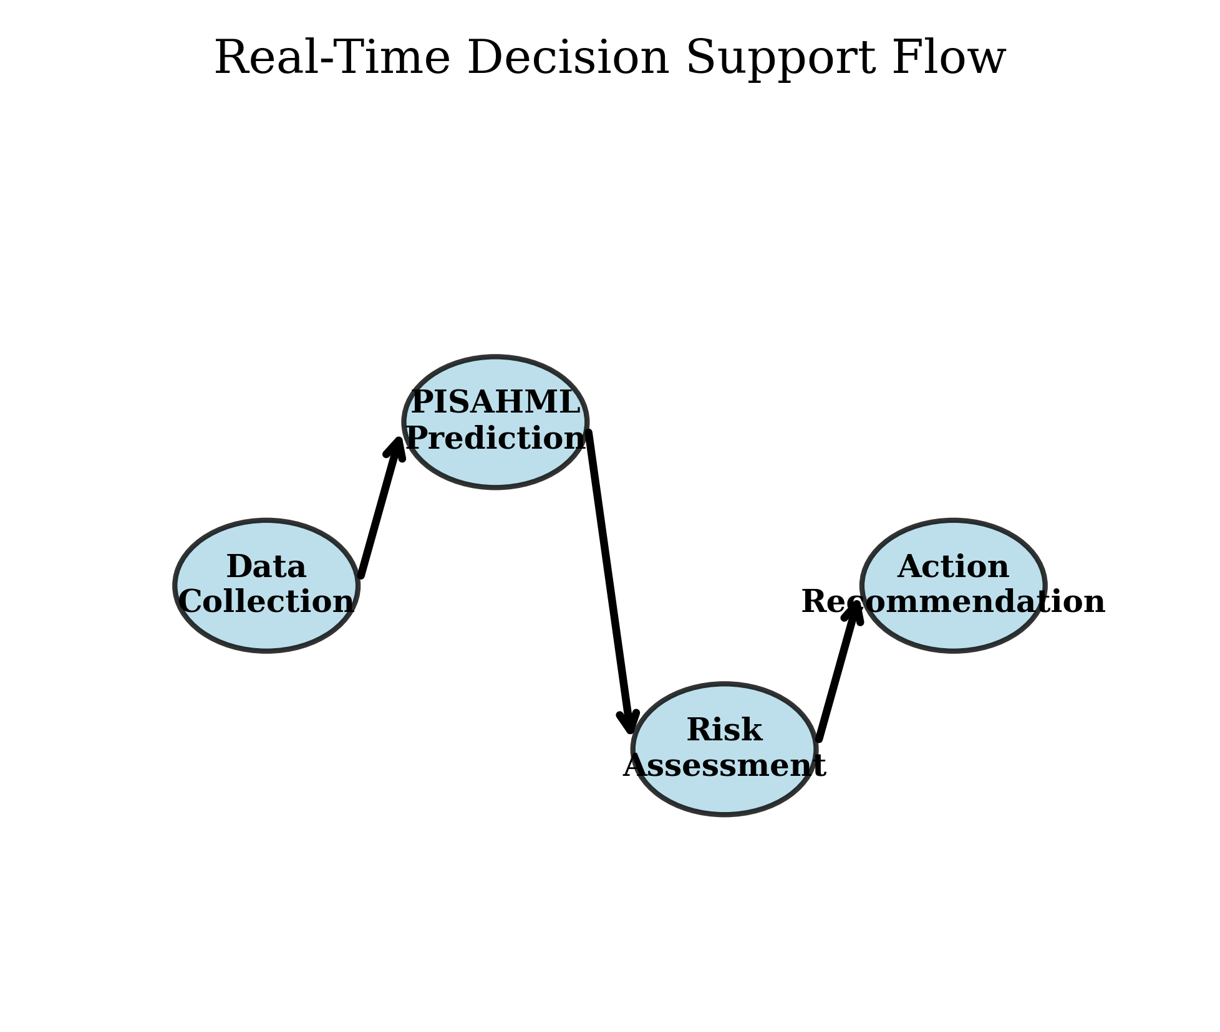

Slide 19
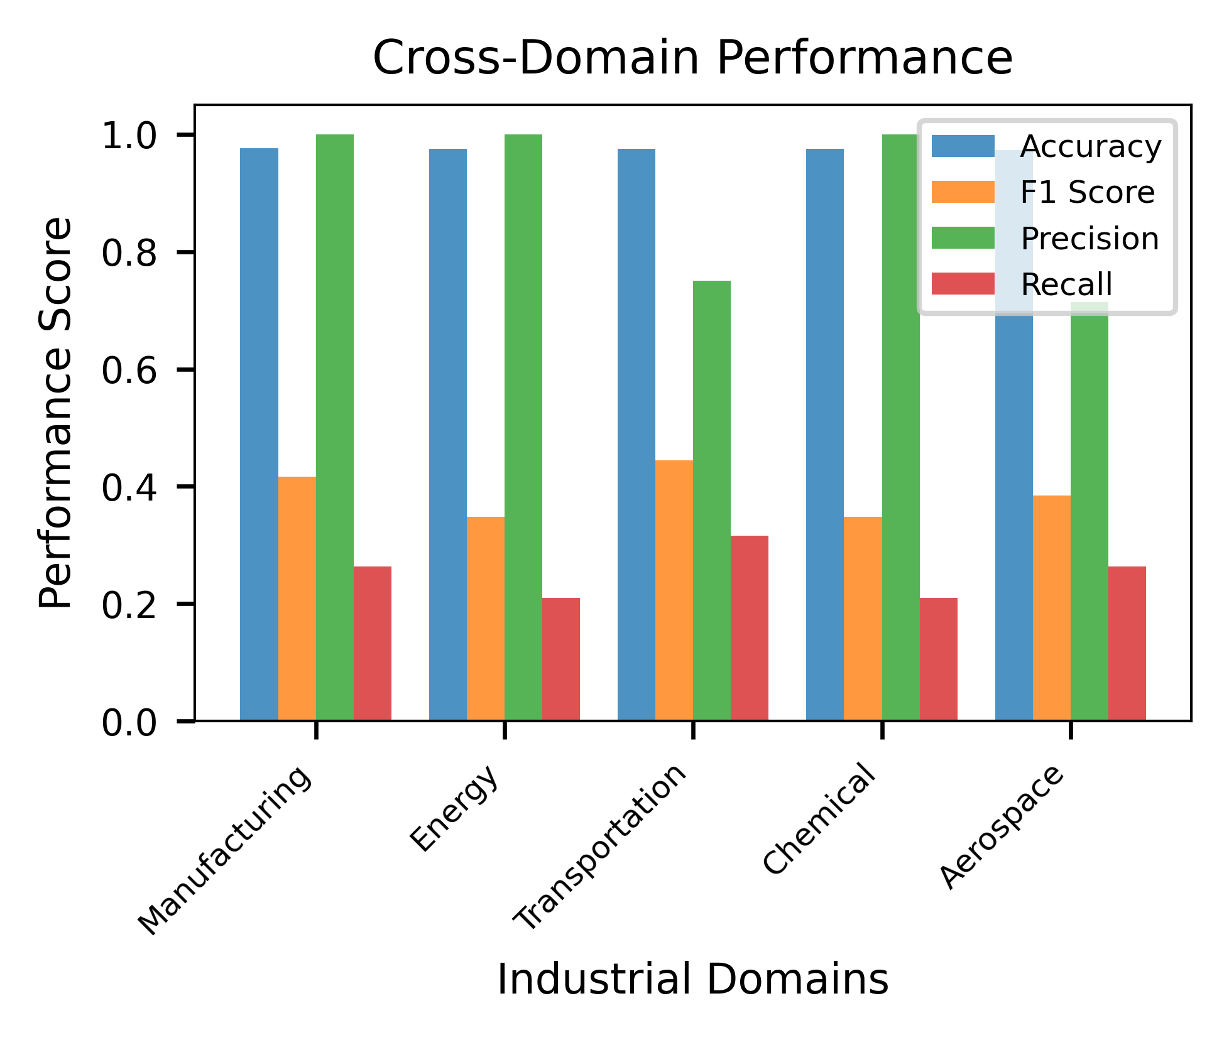
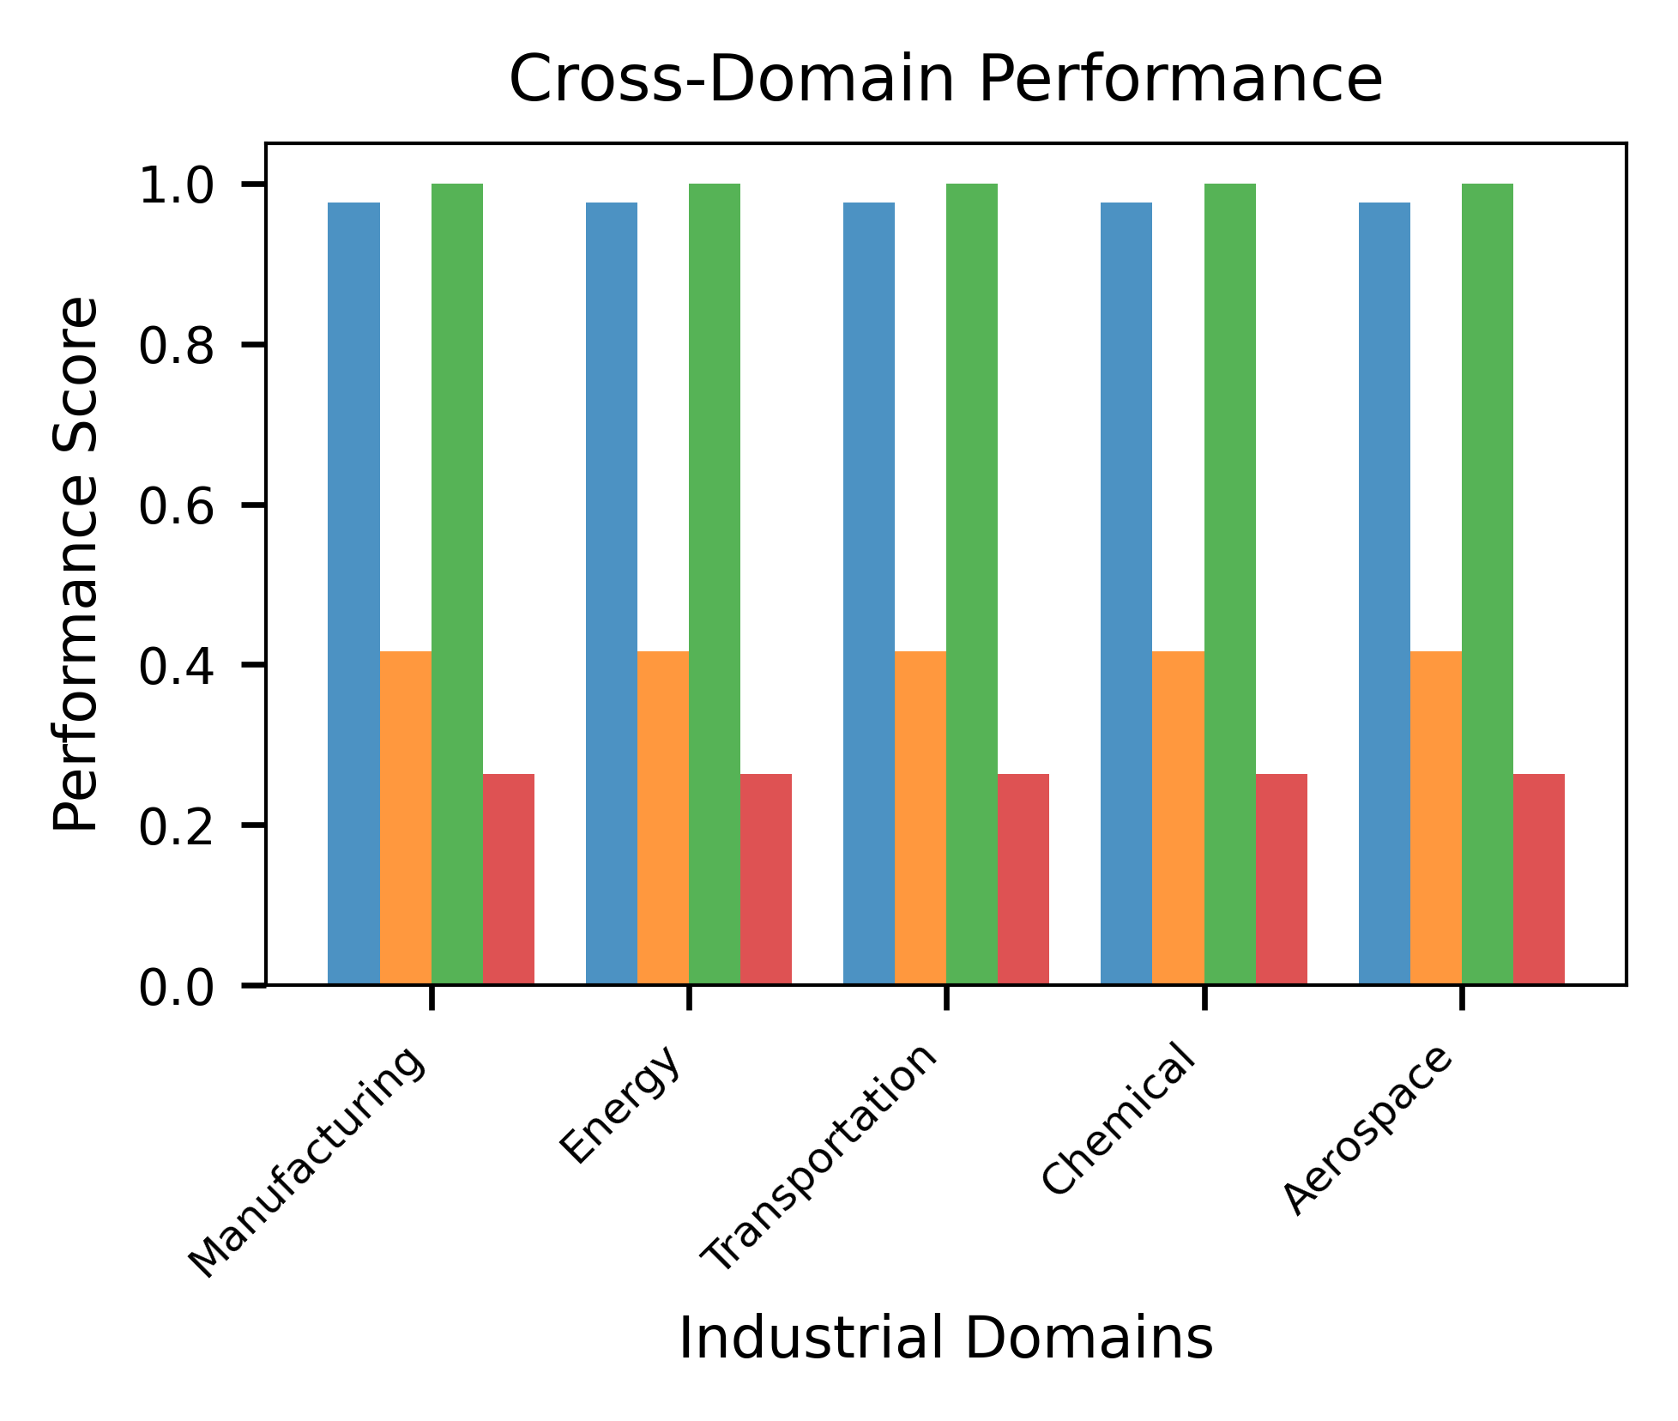
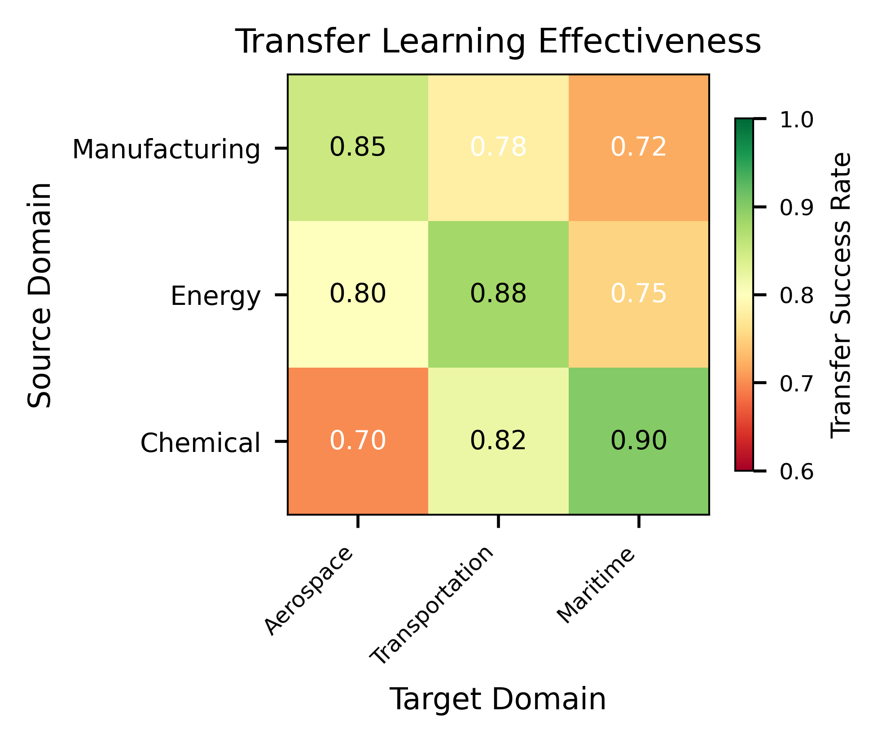
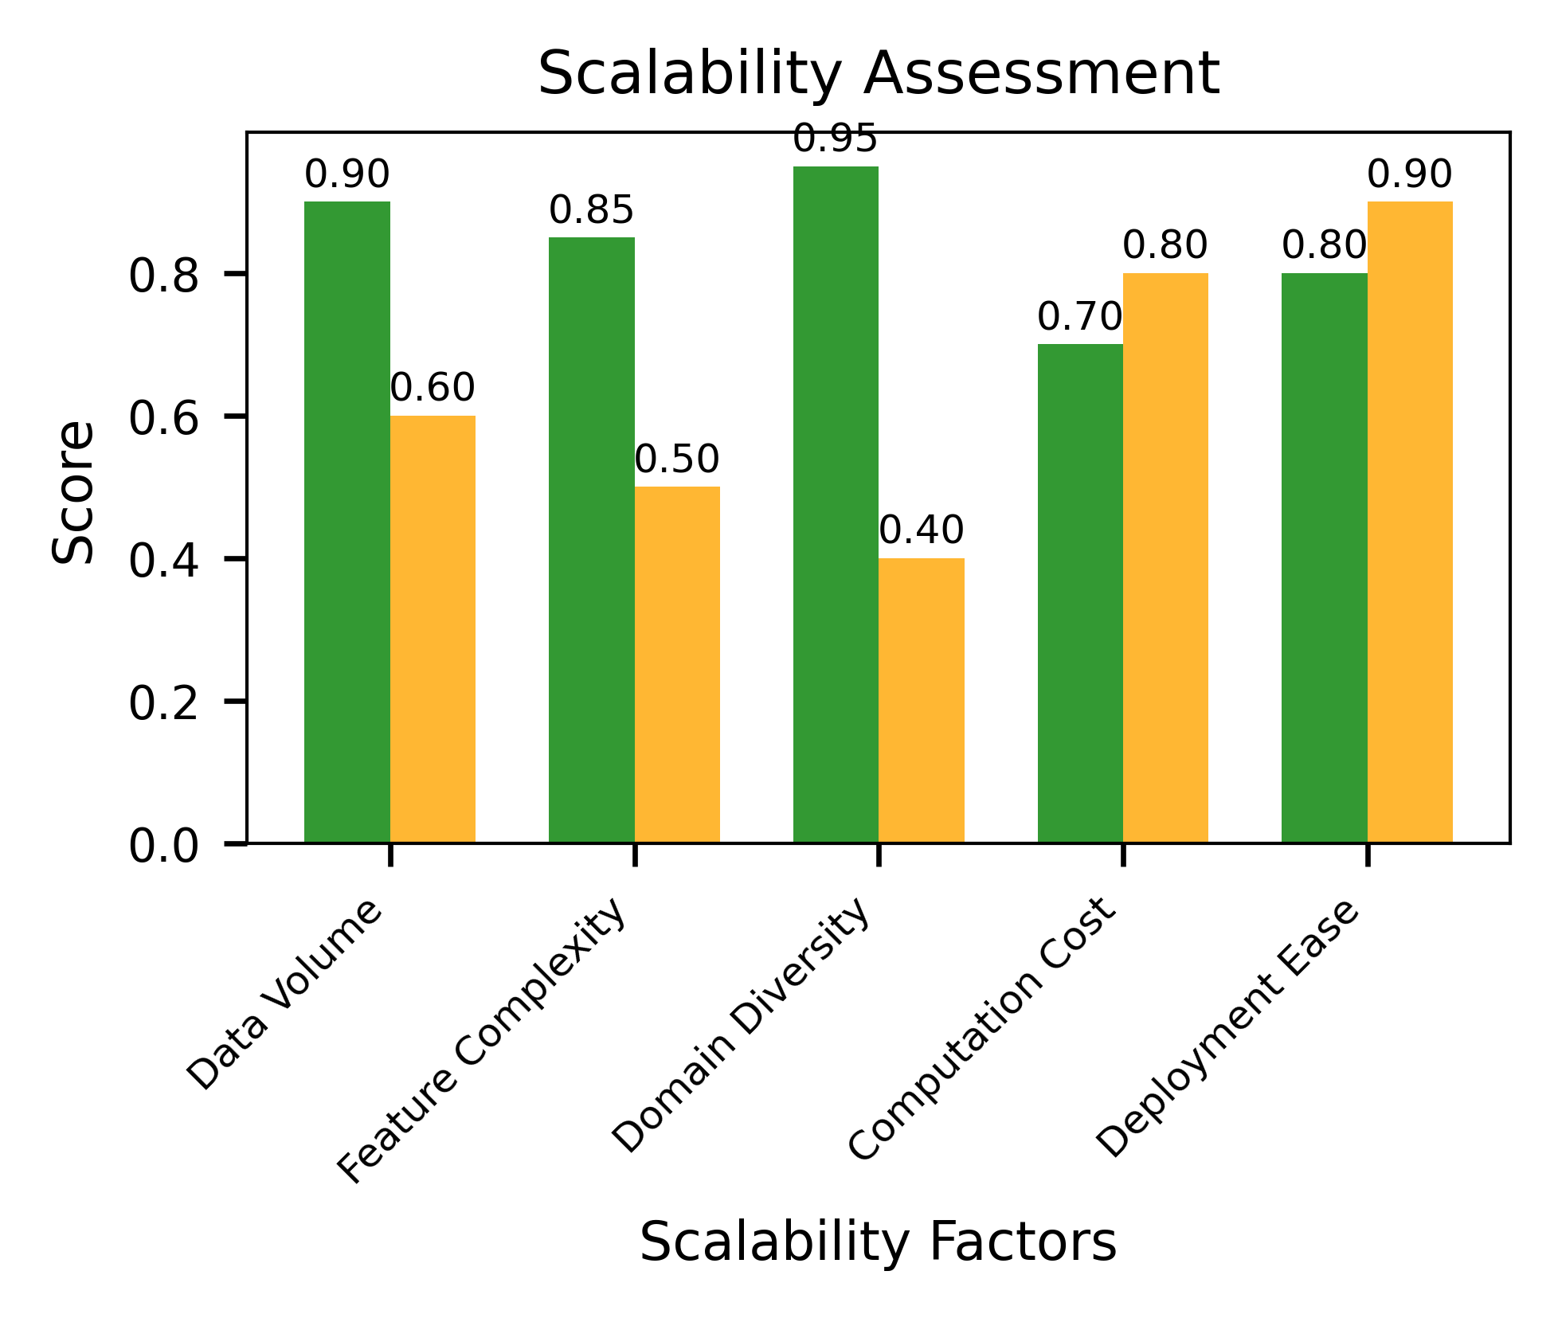
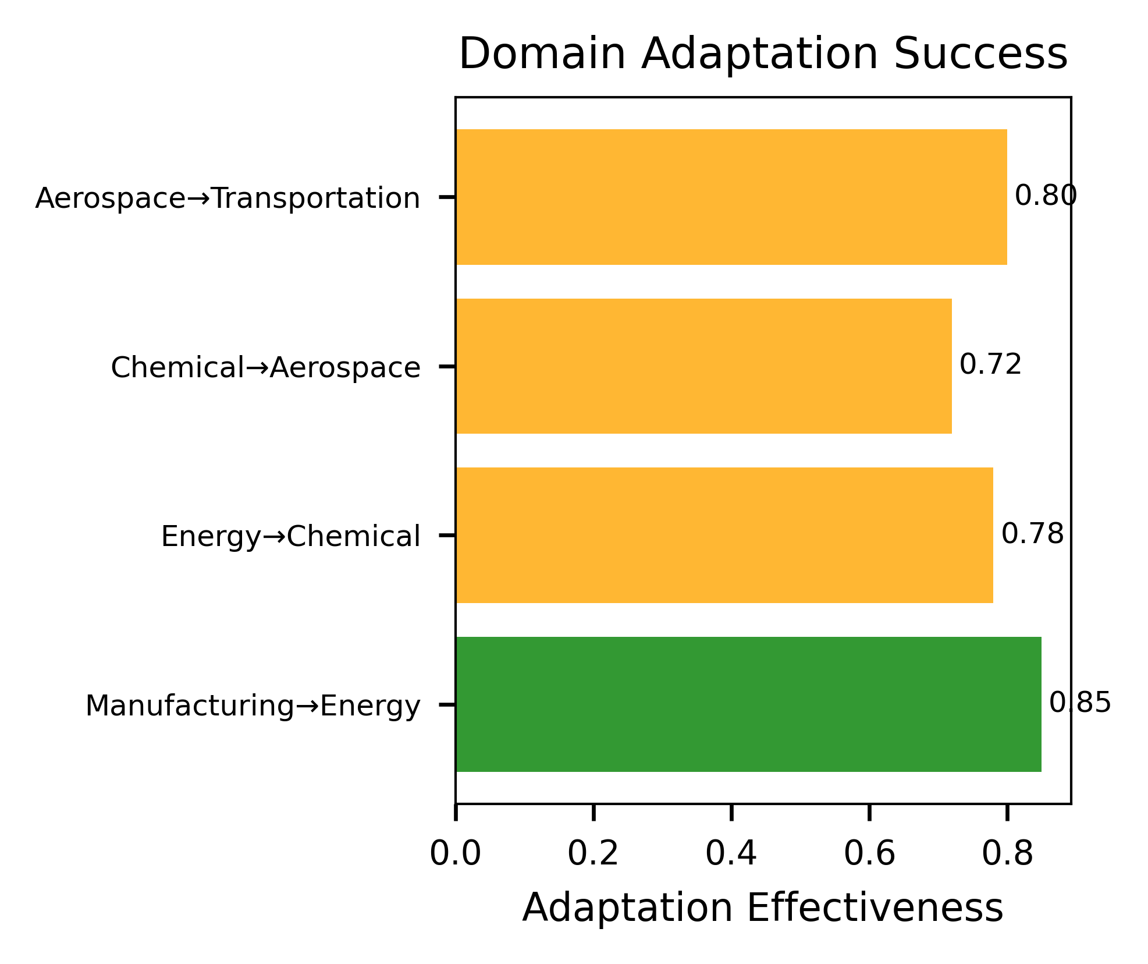
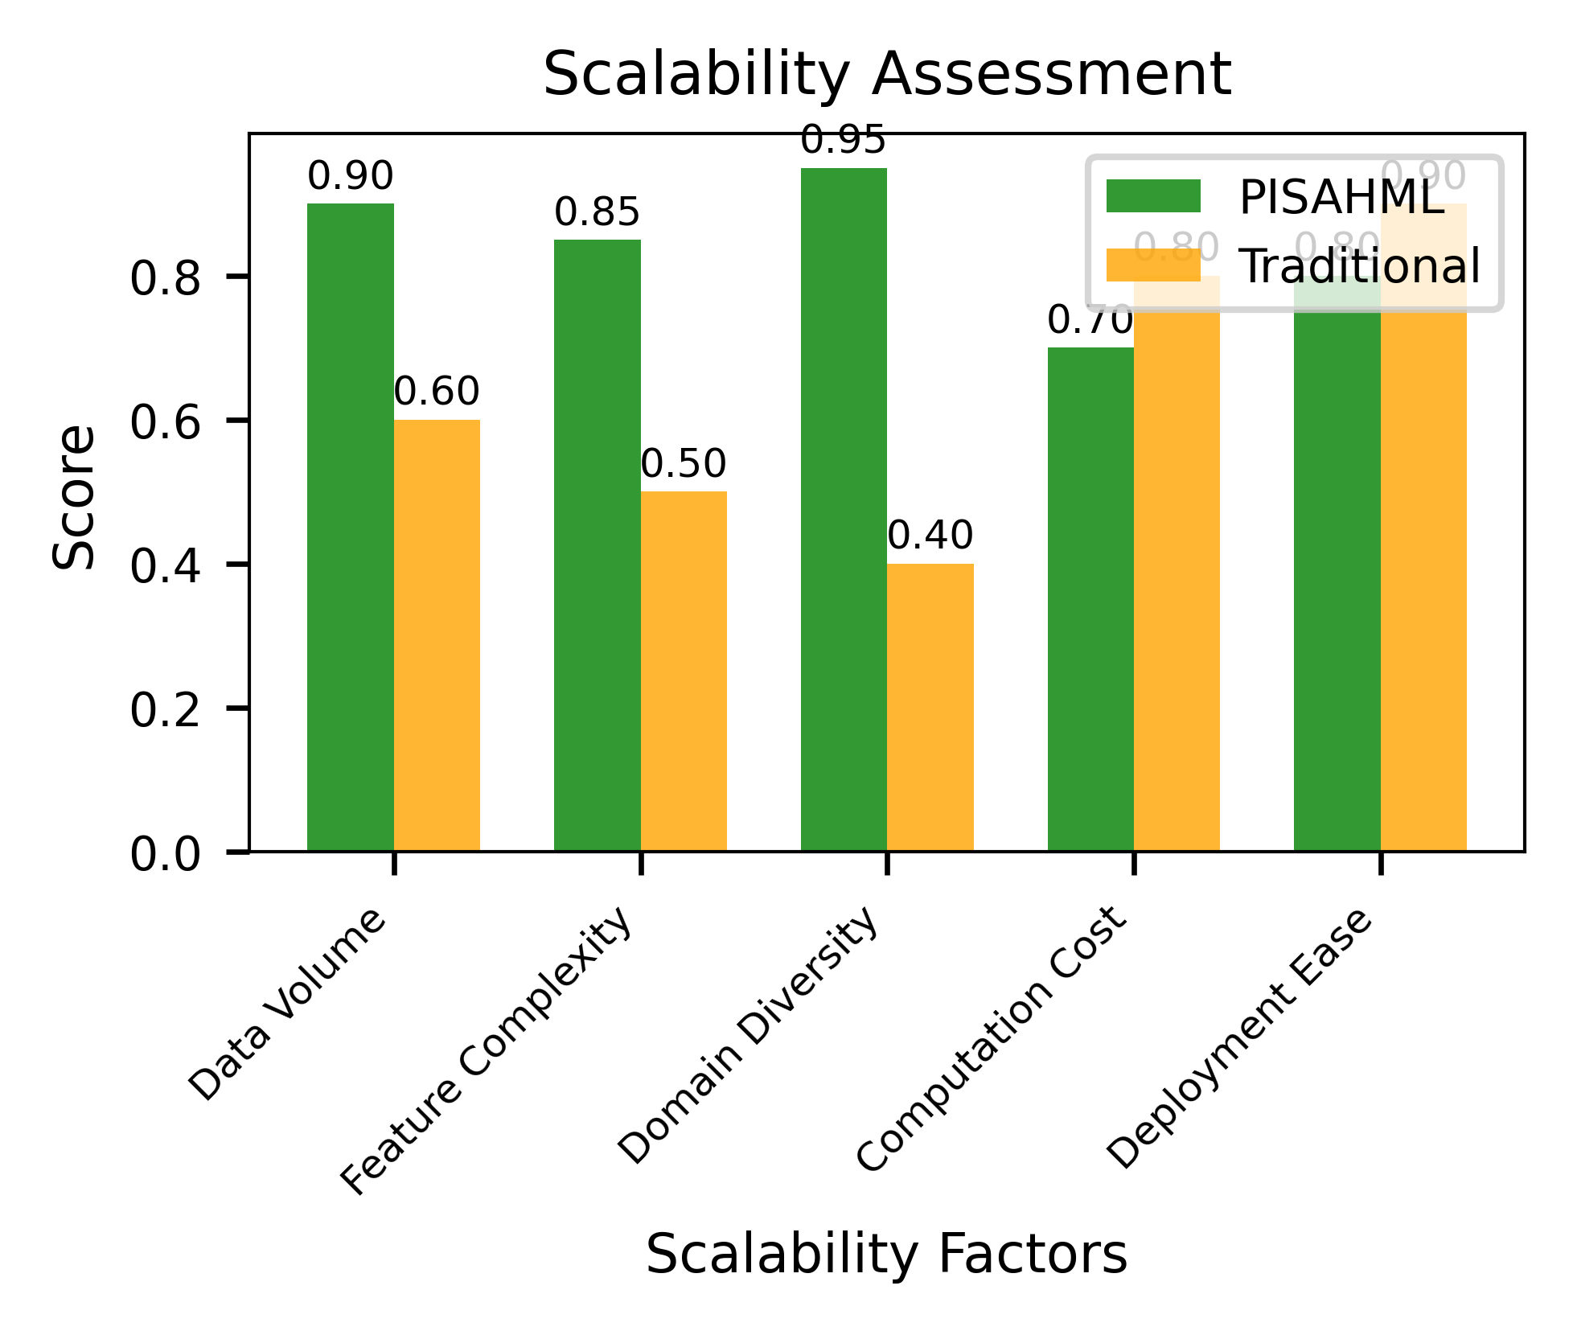
1.0
0.8
Performance score
0.6
0.4
0.2
Energy
Chemical
Manufacturing
Transportation
Aerospace
0.8
0.6
Score
0.4
0.2
0.0
Data Volume
Domain Diversity
Deployment Ease
Feature Complexity
Computation Cost

Slide 20
Manufacturing
Source Domain
Transfer success rate
Energy
Chemical
Aerospace
Maritime
Transportation
Target Domain
Aerospace Transportation
Chemical Aerospace
Energy Chemical
Manufacturing Energy
0.0
0.2
0.4
0.6
0.8
Adaptation Effectiveness

Slide 21
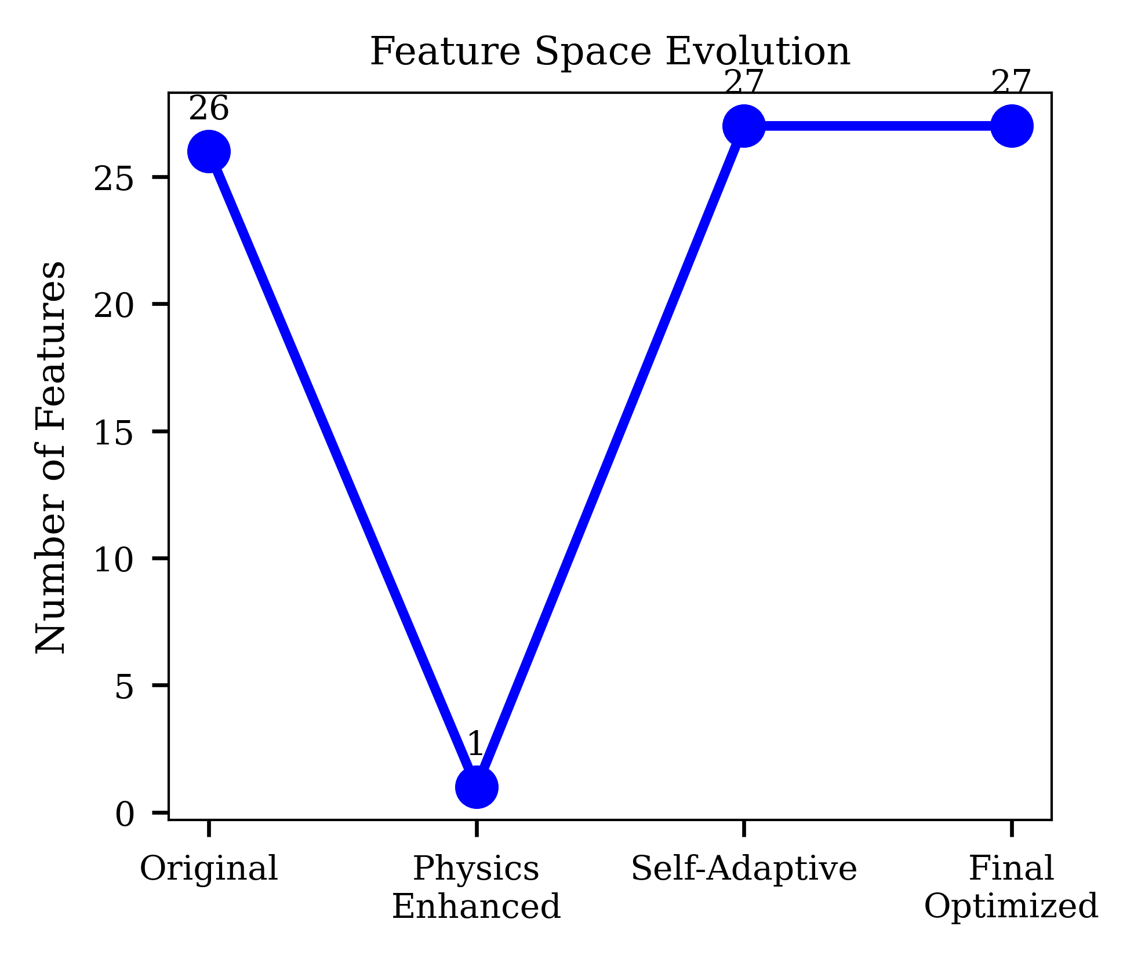
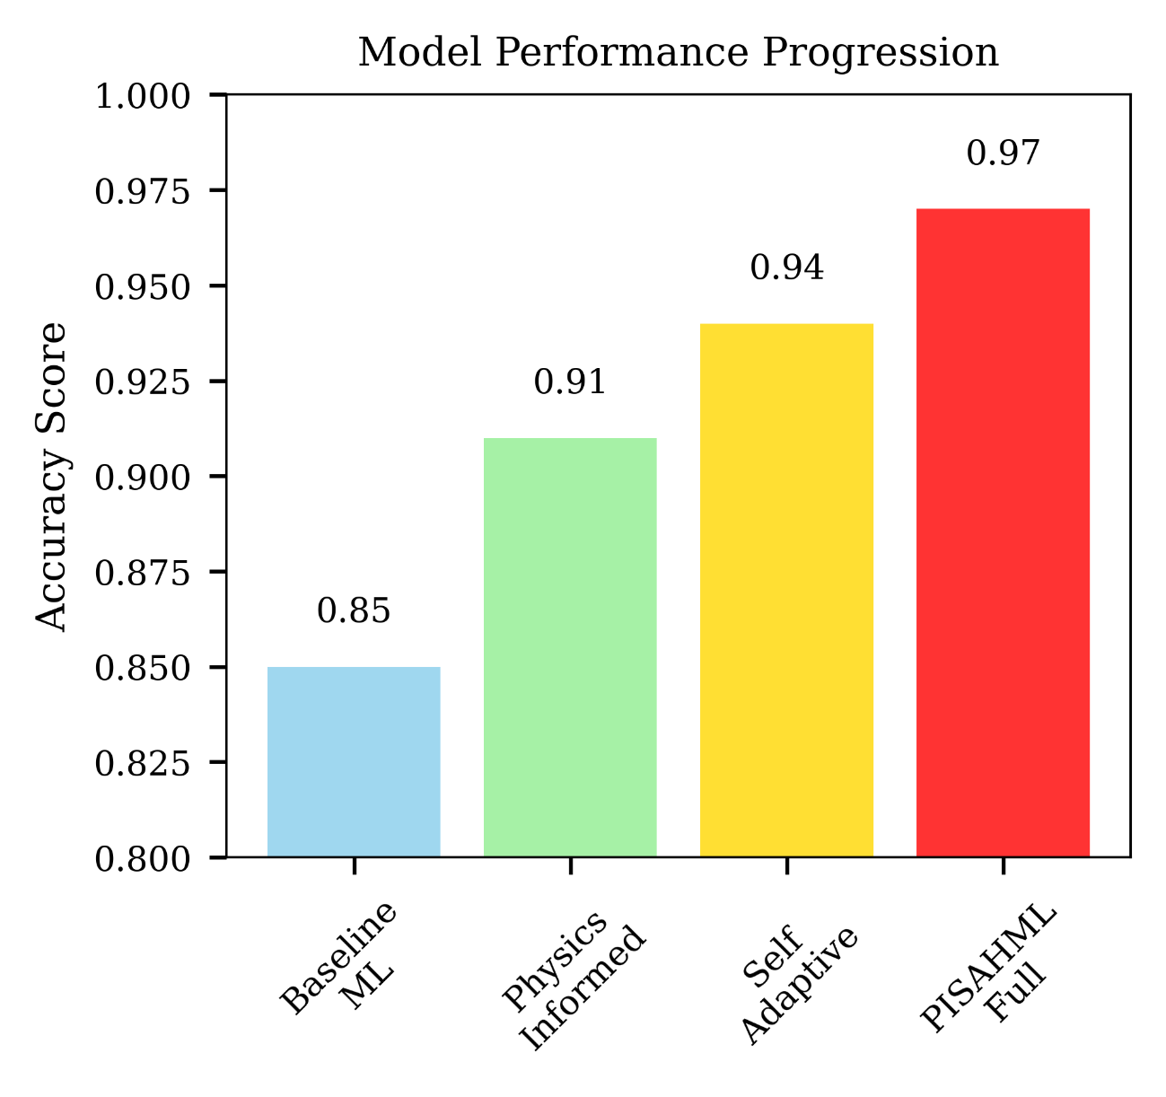


Slide 22







Slide 23



Slide 27


Slide 28


Slide 29


Slide 30


Slide 31




Slide 32



